Slide 1
Responsible Conduct of Research
Biosafety and IBC
Dr. Veena Naik, DVM, MS, Ph.D.
Biosafety Officer | Vice-Chair - IBC

Slide 2
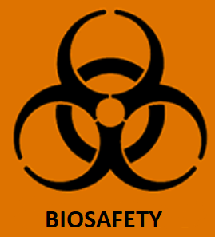
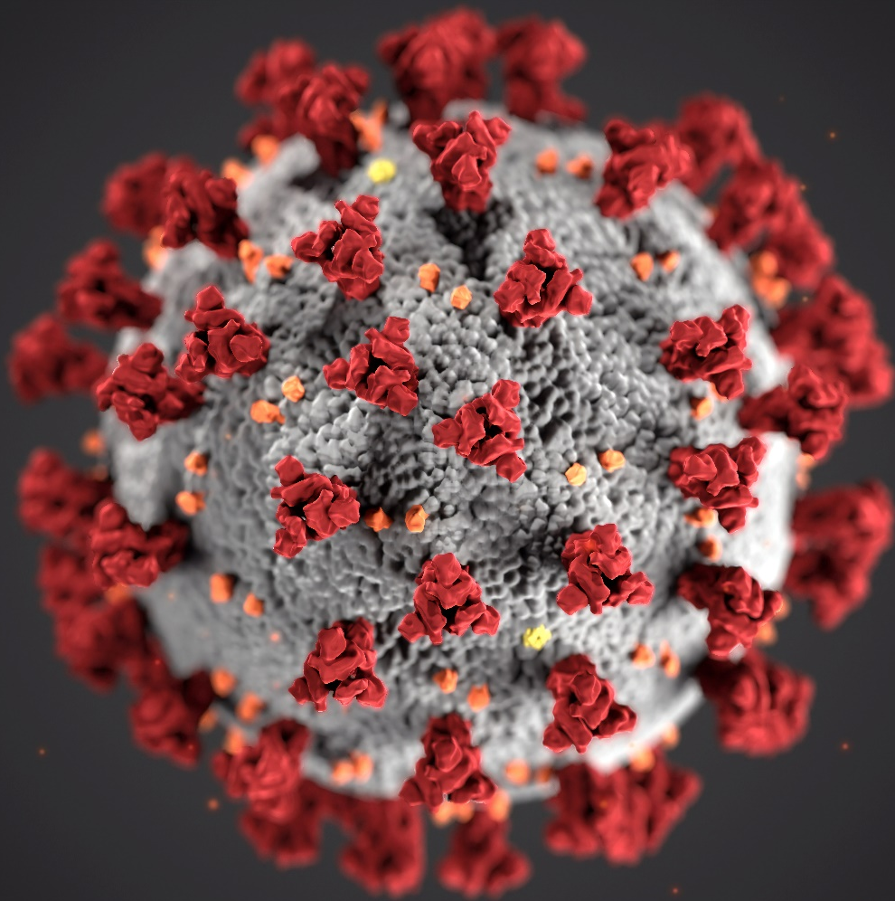
1
Biohazard
Biohazards include biological agents and toxins that have the potential to cause disease in humans, animals, plants and can cause significant damage to the environment. (e.g. - parasites, viruses, bacteria, fungi, prions; and biologically-active materials such as toxins, allergens, and venoms)
2
Biosafety
Framework that describes the use of specific practices, training, safety equipment, and specially designed buildings to contain and protect the researchers, community, and environment from an accidental exposure or unintentional release of infectious agents and toxins.
3
Biosecurity
Ensures the safe use and security of biological materials in laboratories. Biosecurity focuses on protecting biological agents from theft, loss, or misuse.

Slide 3
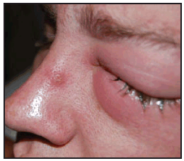
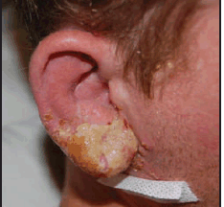
Laboratory acquired Infection
Laboratory acquired infections (LAIs) are defined as all infections acquired through laboratory or laboratory-related activities.
The risk of Laboratory-Acquired Infection (LAI) in employees of clinical and research laboratories are greater than what is seen in the general population.
Left eye and right ear of a man with laboratory-acquired vaccinia virus infection --- Virginia, 2008
Notes:
Vaccinia virus which falls in the family of small pox

Slide 4
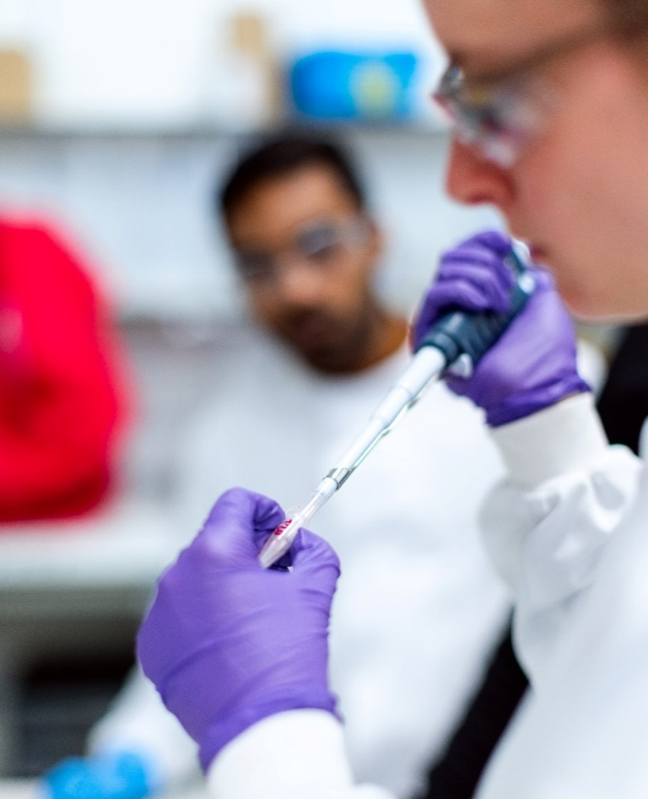
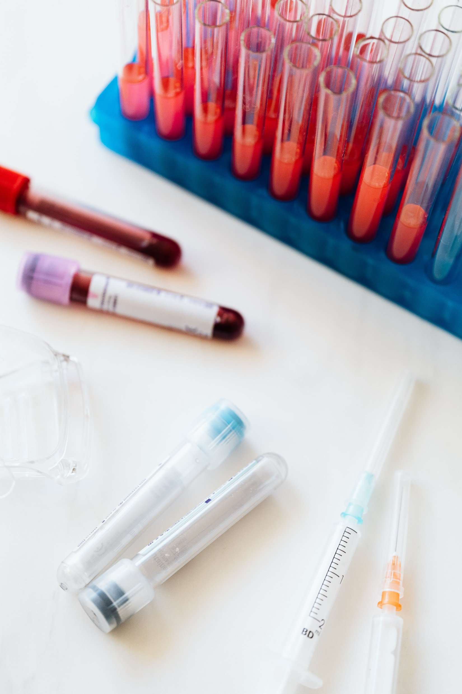
Routes OF Exposure
Inhalation
Procedures that produce aerosols
Inoculation
Needlestick
Ingestion
Splashing to the face,
Contact with skin and mucous membrane
Splashes
Laceration from sharp objects (injury due to blades, scissors, broken glass)
Animal bite and scratch
Contact with contaminated fomites
Entry through broken/ cracked skin
placing contaminated objects in mouth,
Eating/drinking in the space
(pipetting, mixing, sonication changing cages, allergens )

Slide 5
The Institutional Biosafety Committee (IBC):
Why
What
Who
Compliance with the NIH Guidelines is mandatory as a condition of receiving NIH funding for such research.
And to promote the safe conduct of research involving biohazardous materials.
Responsible for reviewing, approving and overseeing research involving the use of recombinant or synthetic DNA/RNA and other biohazards including animals of zoonotic importance in research and teaching labs.
This includes field studies that are performed by UNT faculty, staff, or students off campus.
The IBC must have at least five voting members of specific backgrounds (subject matter experts in recombinant DNA, microbiologist, Animal and Plant research) to provide complete and adequate review of biohazards and its risk.
The Committee also includes at least two member from the local community, who is not affiliated with the institution.

Slide 6
IBC Purview
Since the IBC responsibilities “need not be restricted to recombinant research”, UNT IBC also reviews projects on:
Risk Group 1 and above pathogens
Animals or animal derived research materials
Human derived samples
Xenotransplantation
Stem cell research
Nanotechnology research
Select agents and toxins
IBCs are typically assigned additional review responsibilities
Infectious agents, Biotoxins, or select agents
Human tissue, blood, or most body fluids
Animal tissues, organs, body fluids or Live/dead animals that carry zoonotic diseases
Select Agents and Toxins
Nanotechnology

Slide 7
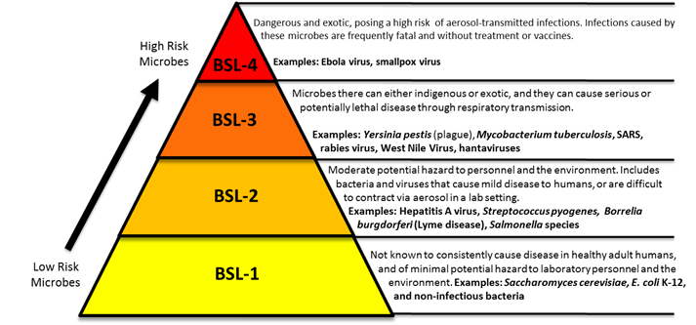
Biosafety Levels at UNT
BSL should be based on the hazardous agent(s) and manipulations of the agent that you will perform.
Labs at UNT

Slide 8
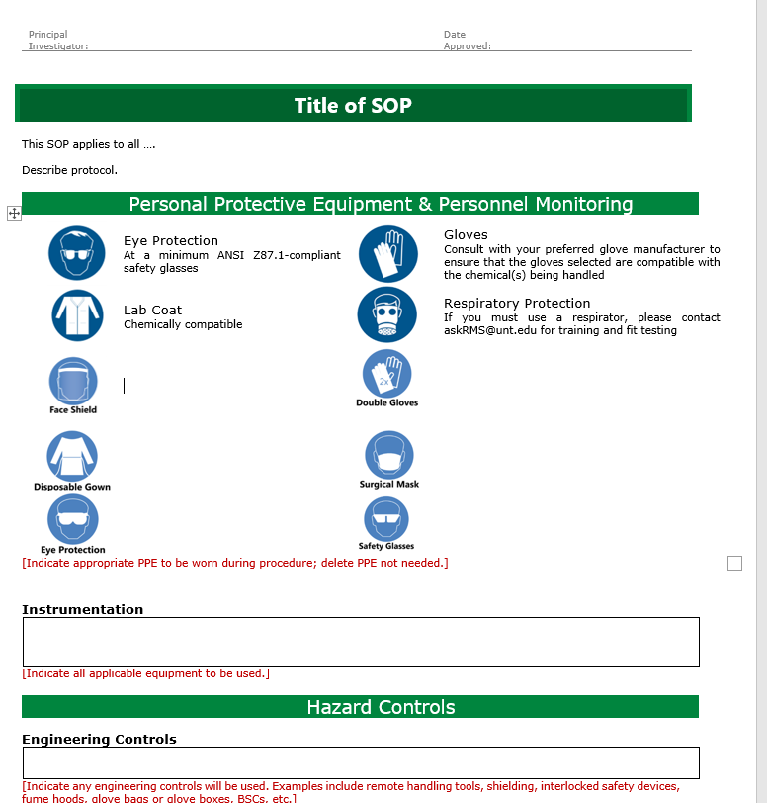
UNT Required Training
All Biosafety related training is now available via CITI
Animal Biosafety (if working with animals)
Initial Biosafety Training
Personal Protective Equipment
OSHA Bloodborne Pathogens (if working with human derived samples)
NIH Recombinant DNA Guidelines (if working with recombinant DNA materials)
Nanotechnology (if working with nano materials)
USDA Permits
Emergency and Incident Response to Biohazard Spills and Releases
Biosafety Retraining (Annual Retraining)
Laboratory Specific Training - PI
Develop and Follow Standard Operating Procedure (SOP) - PI
Notes:
The UNT IACUC requires that methods of euthanasia in animal research protocols be a method approved by the AVMA for each species.

Slide 9
Protocol Review
All new protocols are reviewed by the entire committee. The committee meets on the 2nd Wed of each month. All approved protocols are valid for 3 years.
Approved
Approved with contingency(s)
Tabled
Rejected
Moderate concerns raised or concerns requiring further clarification. Protocol not modified as suggested by IBC
PI must modify protocol and resubmit for full committee review at next meeting.
No work may begin
Significant concerned raised with key components of proposed research (e.g., BSL3 level work in BSL2 lab)
No work may begin, and resubmission of the protocol is not allowed.
Committee has no concerns regarding the protocol
Work may begin immediately
Few or minor issues with the protocol. Committee proposes conditions necessary for approval
PI makes suggested changes in writing., resubmits to BSO/Chair
Then work may begin
Changes to the approved protocol must be submitted via an IBC Amendment Form. Annual Renewal Form must be submitted to indicate that the project will continue

Slide 10
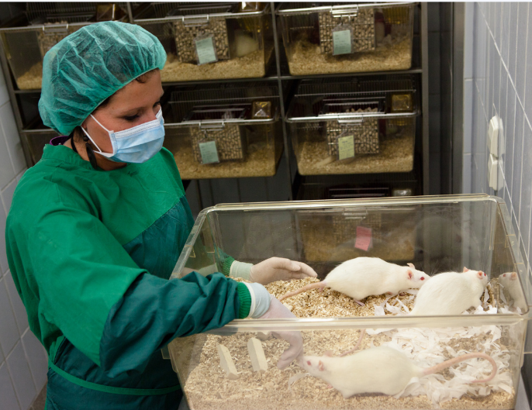
IBC: Scope of Review - Animal Research
IACUC Review
Animal welfare Pain and distress (behavioral, anatomical and physiological abnormalities) Risks to other animals in the facility from the inadvertent spread of vectors Scientific Merit and the three ‘R’
IBC Review ensures
Research for conformity with the NIH Guidelines (ABSL1 and 2) Ways to mitigate/control risk to personnel, UNT Community and environment Adequacy of facilities, SOPs PI and other personnel training Risks to the environment Escape and establishment in the wild Interbreeding with wild stock Consumption by other animals – enter the food chain Research involving animal tissues/organs/body fluids of zoonotic importance
|10
Notes:
reduction, replacement, and refinement.

Slide 11
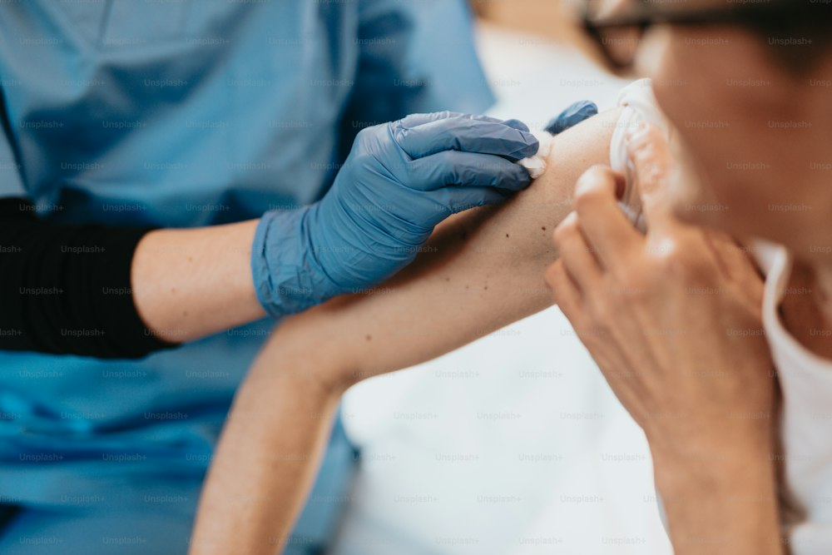
IBC: Scope of Review - Human Subject Research
IRB Review | IBC Review ensures
Conducts risk/benefit assessment relative to individual research participants (physical, psychological, social harms) Selection of subjects and the informed consent process Provisions to protect subject privacy and confidentiality of data Injuries or any other unanticipated problems Compliance with regulations | Research for conformity with the NIH Guidelines, including gene therapy (2019) Potential risk to individual researcher/lab members, health care workers, and the community Adequacy of facilities (BSL 2 and above) PI and other personnel training Institutional and investigator compliance (e.g., adverse event reports) Research involving fresh/frozen -tissues/organs/body fluids from vendors (ATCC)
|11
Notes:
Regenerative Medicine Committee

Slide 12
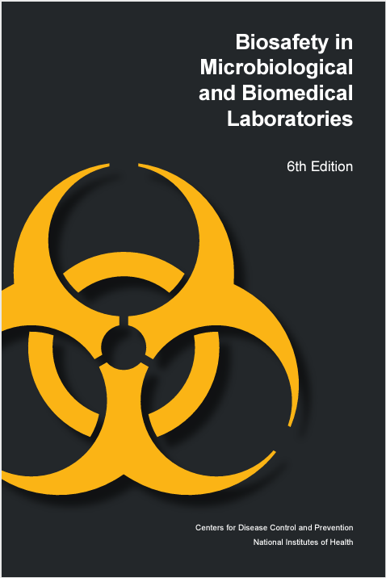
Resources
NIH - The NIH Guidelines for Research Involving Recombinant or Synthetic Nucleic Acid Molecules (2019)
BMBL - Biosafety in Microbiological and Biomedical Laboratories (BMBL) 5th Edition (CDC/NIH)
WHO - World Health Organization Laboratory Biosafety Manual – Third Edition (WHO)
CDC - Guidelines for Safe Work Practices in Human and Animal Medical Diagnostic Laboratories (CDC)
UNT Policy - https://research.unt.edu/research-services/research-integrity-and-compliance
OSHA regulations - https://www.osha.gov/laws-regs/regulations/standardnumber/1910/1910.1030
Notes:
Additional Biosafety Guidance Resource

Slide 13
Support
Support/ Questions
IBC
Veena Naik
IBCprogram@unt.edu | veena.naik@unt.edu
Thank you!

