Slide 1
Responsible Conduct of Research
Conflict of Interest
February 27, 2024

Slide 2
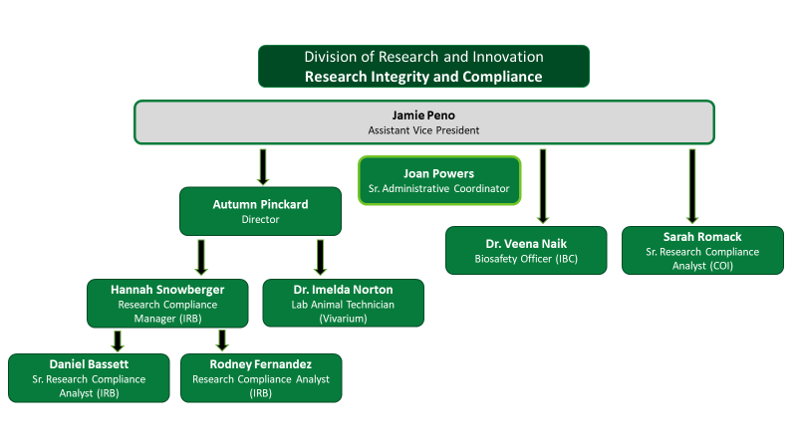
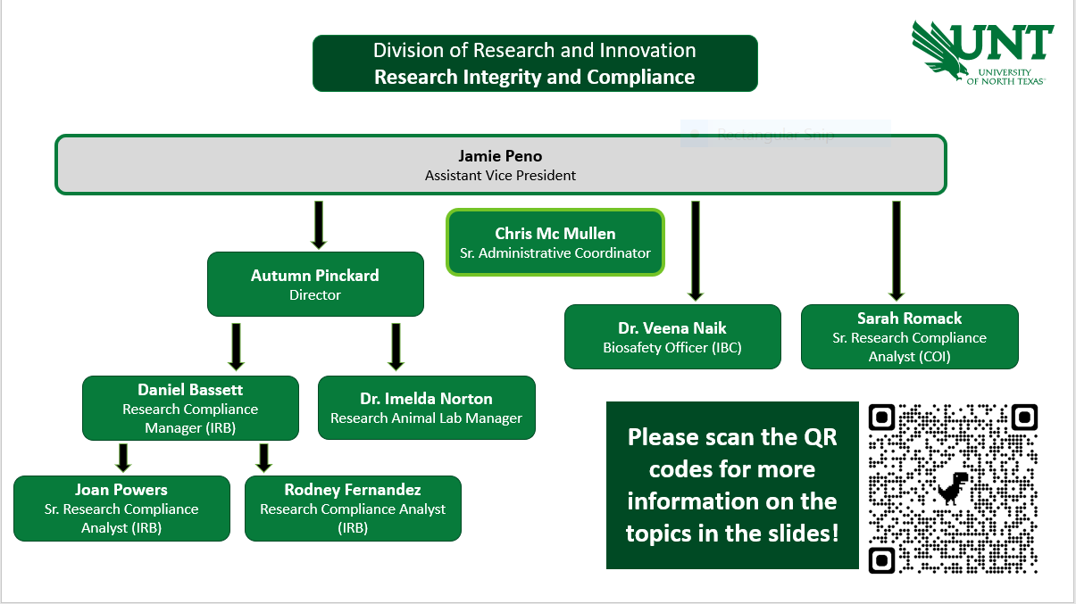
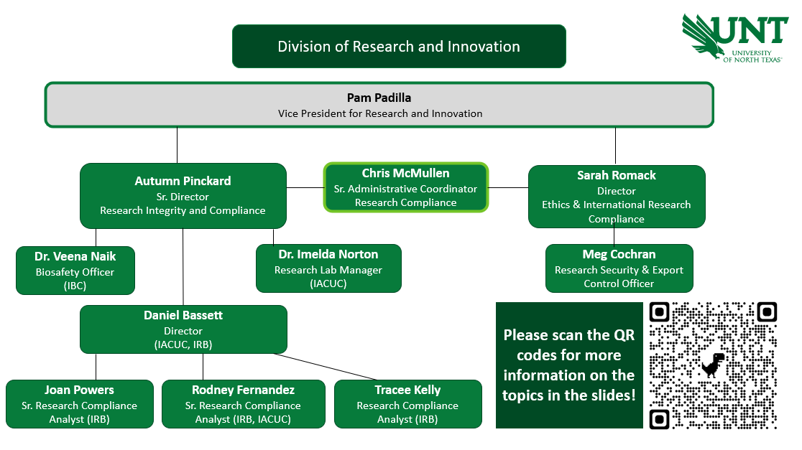
Division of
Research and Innovation
Research Integrity and Compliance
Jamie Peno
Assistant Vice President- RIC
IRB
COI
IACUC
Export Control
RCR
Christina Cantu
Sr. Administrative Associate
Hannah Snowberger
Sr. Research Compliance Analyst
Autumn Pinckard
Research Compliance Manager
Sarah Romack
Research Compliance Analyst
IRB
IRB
IACUC
COI
Operations

Slide 3


What are we going to talk about?
What is the goal of the Conflict of Interest Program?
What is a COI? What is an SFI?
Why should you care about COIs?
COI Filing Process
Management Plans
SBIRs/STTRs
Q&A

Slide 4
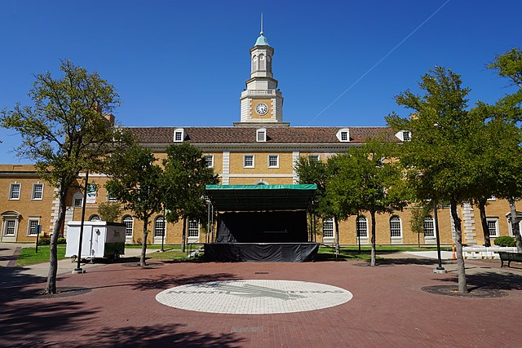
What is the goal of a COI program?
Promote objectivity in research
Support faculty entrepreneurship, support industry engagement
Meet sponsor, public, regulatory, and legal requirements
Preserve research integrity
Protect academic freedom
Protect human participants
Protect interests of students and staff
This Photo by Unknown Author is licensed under CC BY-SA

Slide 5
What is a Conflict of Interest?
A financial conflict of interest related to research exists when a financial interest – or other opportunity for personal financial gain – is likely to compromise or influence—or appear to compromise or influence—the objective design, conduct, reporting, or direct administration of research.
Conflicts are a set of intersecting relationships; they are not inherently bad, but they must be properly managed to protect the integrity of UNT research.

Slide 6

What is a Significant Financial Interest?
Examples of an SFI include:
Salary/Consulting Fee
Equity: stock, stock options, ownership
Income from Intellectual Property
Travel sponsored by outside agency
Report anything earned by investigator, spouse, or dependent children.
This Photo by Unknown Author is licensed under CC BY-ND

Slide 7
What is a not a Significant Financial Interest?
Examples of non-SFI include:
UNT Salary or UNT-funded travel
Investments like Mutual Funds or Retirement Accounts
  Investigator is not directly controlling the investment
Income from seminars/lectures sponsored by a government agency, college/university, teaching hospital, or research institute affiliated with college/university.
Income from advisory committee or review panel from government agency, college/university, teaching hospital, or research institute affiliated with college/university.

Slide 8
Why should you care about COIs?
Public may lose trust in the University
Loss of investigator/faculty member credibility in the academic community
Protection of human subjects and integrity of research may be compromised
University may lose research funding

Slide 9
PHS Agencies
Agency for Healthcare Research and Quality (AHRQ)
Agency for Toxic Substances and Disease Registry (ATSDR)
Centers for Disease Control and Prevention (CDC)
Food and Drug Administration (FDA)
Health Resources and Services Administration (HRSA)
Indian Health Service (IHS)
National Institutes of Health (NIH)
Office of the Assistant Secretary for Health (OASH)
Office of the Assistant Secretary for Preparedness and Response (ASPR)
Office of Global Affairs (OG)
Substance Abuse and Mental Health Services Administration (SAMHSA)

Slide 10
PHS-specific Requirements
PHS COI Training required before engaging in research & every 4 years. Also:
  when UNT revises its financial conflict of interest policies or procedures in any manner that affects the requirements of Investigators;
  when an Investigator is new to UNT; or
  when UNT finds that an Investigator is not in compliance with UNT’s financial conflict of interest policy or procedures or management plan.
COI Policy must be:
  Written & up-to-date
  Available via publicly accessible website
ORIC office must:
  Provide initial & ongoing reports to PHS about FCOI
  Maintain records of disclosures for at least three years from the date the final expenditures report is submitted to the PHS or, where applicable, from other dates specified elsewhere in this procedure for different situations

Slide 11

COI Filing Process
Researchers (PI, co-PI, Key Personnel) must submit a COI Disclosure:
at the time of proposal
annually thereafter
within 30 days of a new Significant Financial Interest
COI Disclosure Review steps:
Disclosure submission
RIC office reviews
COI committee reviews
Collaborate with researchers on their management plans
Execute the management plan
This Photo by Unknown Author is licensed under CC BY-SA-NC

Slide 12
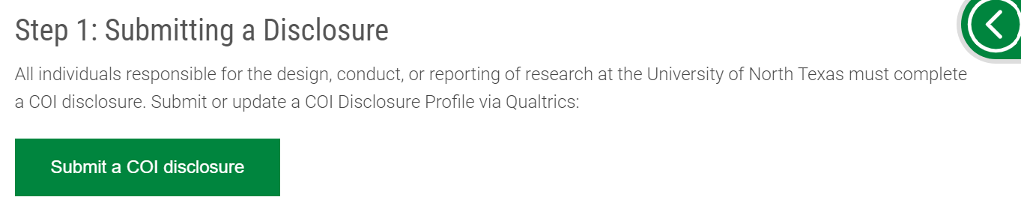
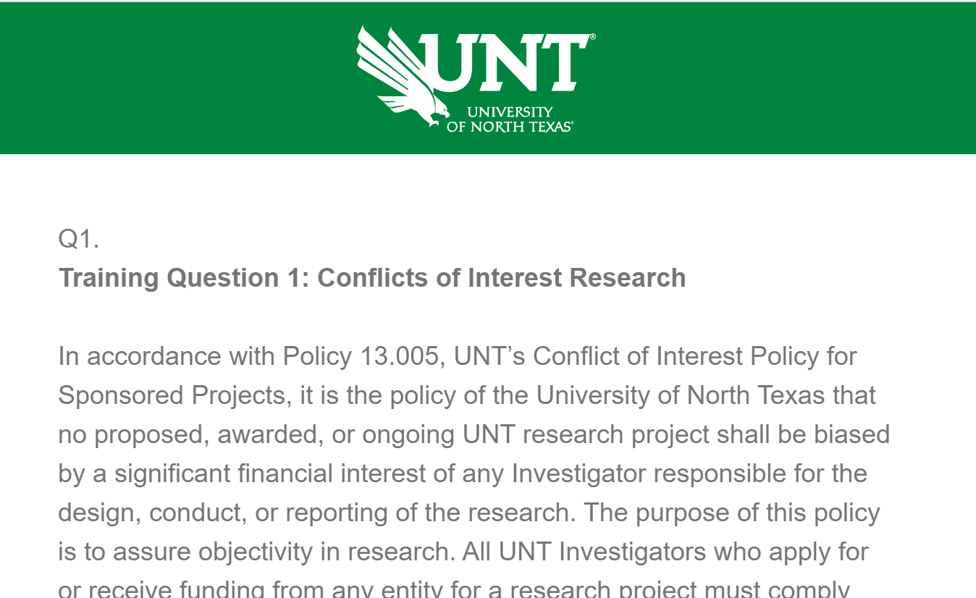
COI Step-by-Step in Qualtrics
On the UNT RIC COI website, click Submit a COI Disclosure.
2. You will submit via Qualtrics survey

Slide 13
PAPPG 24-1 MFTRP Certification
On February 19th, the NSF officially released the Proposal & Award Policies & Procedures Guide 24-1.
It goes into effect on May 20, 2024
In anticipation, our office added a question about Malign Foreign Talent Recruitment Program on January 1, 2024
Even if you submitted a COI Disclosure on 12/31/23, you’ll need to submit a new disclosure if submitting a proposal

Slide 14
Malign Foreign Talent Recruitment Program
A Foreign/international talent recruitment program (FGTRP) is an effort organized, managed, or funded by a foreign government, or a foreign government instrumentality or entity, to recruit science and technology professionals or students (regardless of citizenship, national origin, or full-/part-time status).
Incentivizing/compensating the FGTRP participant to relocate physically to a foreign country in order to import/acquire the proprietary technology, software, etc.;
Allowing for or encouraging the FGTRP participant to receive U.S. Federal research funds while concurrently working at and/or receiving compensation from a foreign institution for the same, or similar, work;
Directing FGTRP participants not to disclose their participation to United States entities;
Compelling FGTRP participants to enter into contracts that conflict with their responsibilities to UNT, or that are disallowed by UNT
OFAC-sanctioned countries: Russia, Iran, China and North Korea

Slide 15

COI Review Process
Research Integrity & Compliance Office Review
Conflict of Interest Committee Review
Management Plan Creation & Follow-up
COI Management Plans:
Outline the nature of the Significant Financial Interest
Discuss data protection & storage
Identify other faculty & students involved with project
Name an Oversight Committee
Outline stipulations for purchasing
This Photo by Unknown Author is licensed under CC BY

Slide 16
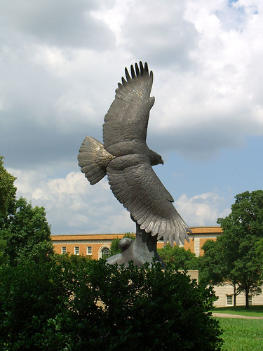
Managing Conflicts
Disclosure statements in journals/presentations
Student Acknowledgement forms
Modification of the Research Plan
Change of personnel or responsibilities
Reduction or elimination of financial interest
Severance of ties that create financial conflict
This Photo by Unknown Author is licensed under CC BY-SA

Slide 17

Small Business Innovation Research (SBIR) & Small Business Technology Transfer (STTR)
Programs administered by US Small Business Association
Funding source for start-ups & small businesses
Goals
  Stimulate technological innovation
  Use small business to meet Federal R&D needs
  Encourage socially/economically disadvantaged
  and women-owned businesses
  Increase private sector commercialization
This Photo by Unknown Author is licensed under CC BY

Slide 18
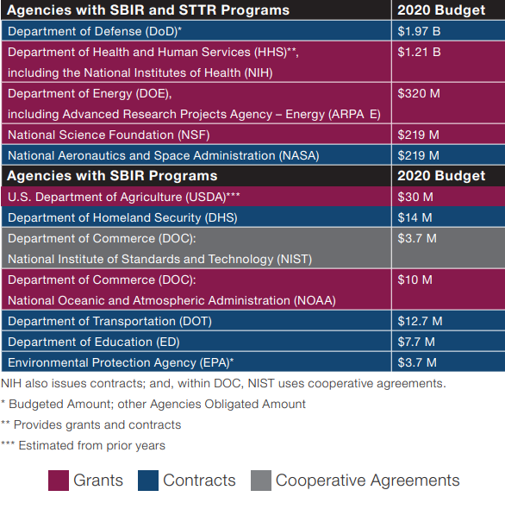
Small Business Innovation Research (SBIR) &
Small Business Technology Transfer (STTR)
Eligibility
  Small firm (<500 employees)
  At least 51% US-owned
  PI must be employed by firm
  NIH allows co-PIs
  During Phase I/II, 30% of research subcontracted
  to a university or federal lab
How are these handled at UNT?
  Always require a COI Management Plan
  Work with Research Commercial
  Agreements Office

Slide 19
COI Resources (on our website!)
UNT’s COI Policy
2011 PHS Conflict of Interest Regulations, 42 CFR Part 50, Subpart F
NIH Conflict of Interest Page
NIH FAQs
Summary of Major Changes from 1995 to 2011 COI Regulations
DOE Interim Conflict of Interest Policy

Slide 20
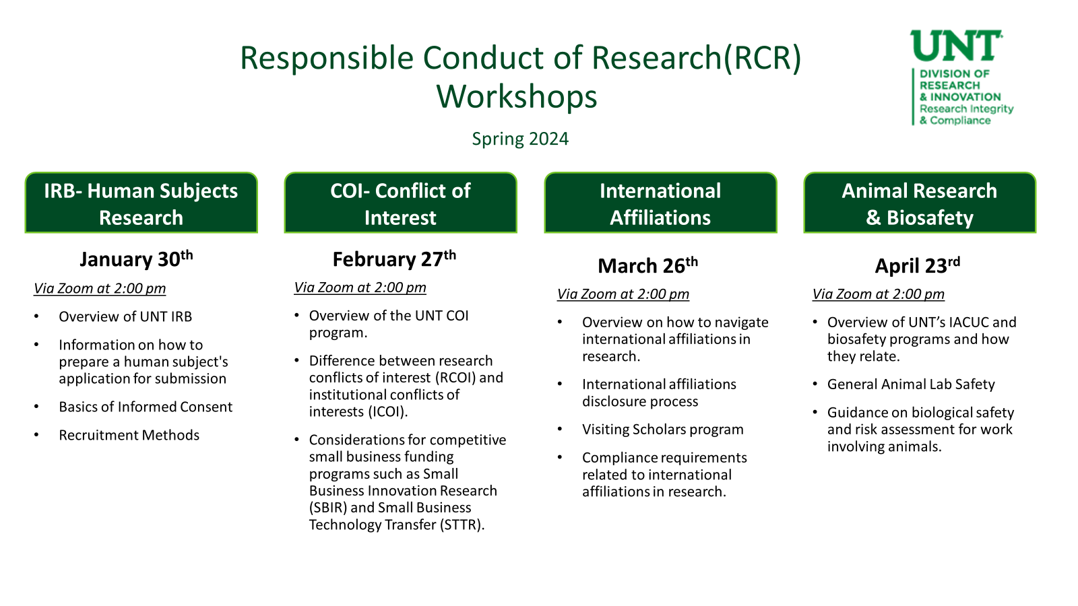
Questions?
THANK YOU!
Phone: 940-565-4643
Email: untcoi@unt.edu

Slide 21
Questions?
THANK YOU!
Phone: 940-565-4643
Email: untcoi@unt.edu

