Slide 1
Responsible Conduct of Research
International Affiliations
October 17, 2023

Slide 2
Today’s Agenda
What is the goal of the International Affiliations Program?
Where/how should disclosures be made?
IA Disclosure Filing Process
Dean Reports
Overlap with COI /Dual Employment
Scenarios/Conclusion
Q&A

Slide 3
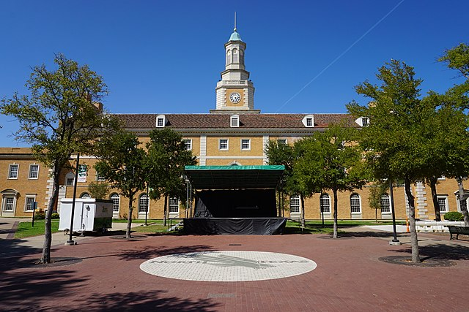
What is the goal of an International Affiliations program?
Encourage, support, & foster faculty collaboration
Address US Government sponsors’ concerns
Meet university and legal requirements
Preserve research integrity
Protect academic freedom
Protect human participants
Protect interests of students and staff
This Photo by Unknown Author is licensed under CC BY-SA

Slide 4
Where/how should disclosures be made?
In Proposals, Progress Reports, and Final Reports:
• Identify all sites where work will be performed, domestic and abroad.
• Biosketch (NIH, DOD, NSF, DOE, etc): Identify all appointments at foreign entities, participation in foreign talent program(s) and all foreign relationships and activities.
• Current & Pending Support: Identify all financial resources, domestic and foreign, supporting your research.
• Foreign components: Identify all known foreign components to a research project in the initial proposal and update as necessary via subsequent progress reporting.
Adapted from: https://customsitesmedia.usc.edu/wp-content/uploads/sites/522/2020/11/20184132/Foreign-Influence-presentation-11.18.20FINAL.pdf

Slide 5
Where/how should disclosures be made?
During the Award:
If a foreign component arises during the life of the award and was not disclosed in the initial proposal, obtain sponsor’s approval through a progress report or stand-alone request.
At the University:
• All research activity at another institution requires disclosure to the appropriate Dean and the Vice President of Research & Innovation via the International Affiliations disclosure process.
• Academic titles at other institutions (foreign or domestic), including full-time, parttime, visiting, adjunct, honorary, or voluntary appointments, require approval from the Dean via Dual Employment form.
• All researchers regardless of sponsor or title must submit an International Affiliations disclosures
Adapted from: https://customsitesmedia.usc.edu/wp-content/uploads/sites/522/2020/11/20184132/Foreign-Influence-presentation-11.18.20FINAL.pdf

Slide 6
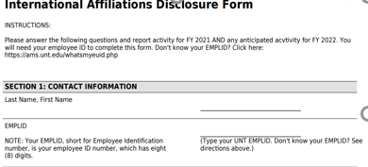
How do I submit my IA Disclosure?
What do I need to disclose?
A link to a RedCap survey will be sent every April.
You will be asked about:
Support
Affiliations
Financial
Agreements & Contracts
Travel
Visitors
Exports

Slide 7
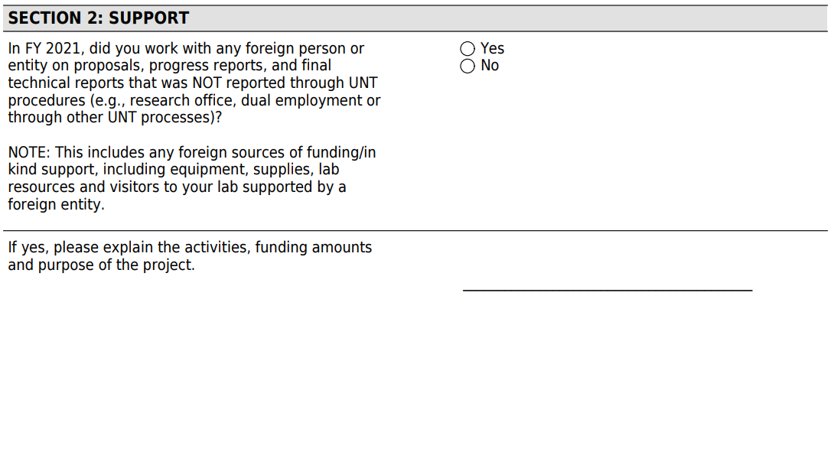
What do I need to disclose?
Support during proposals, progress reports, or final reports
Funding
In-Kind
Equipment
Supplies
Lab resources

Slide 8
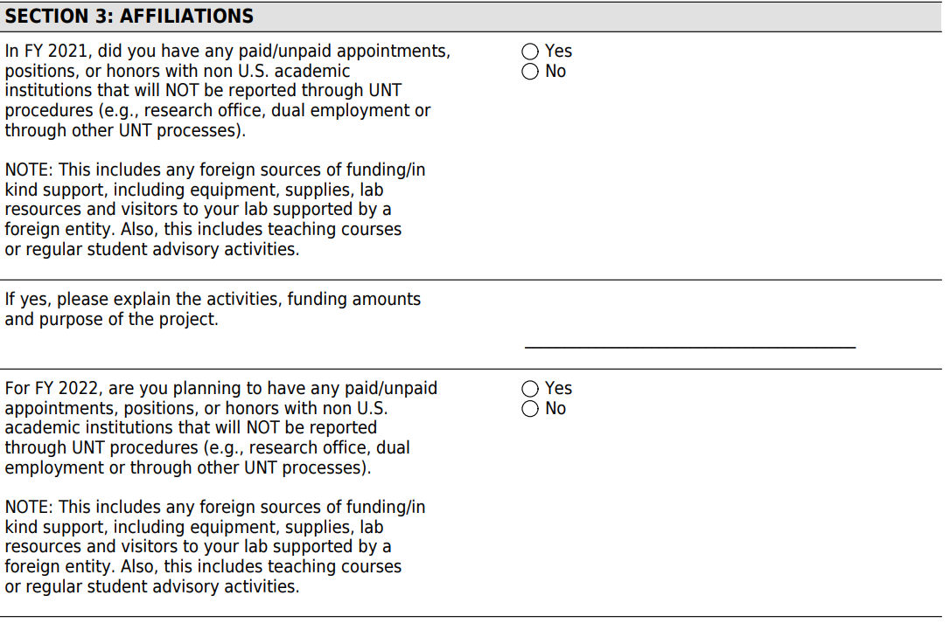
What do I need to disclose?
Affiliations
Paid or unpaid appointments
Paid or unpaid positions
Honors
Teaching
Student advisory

Slide 9
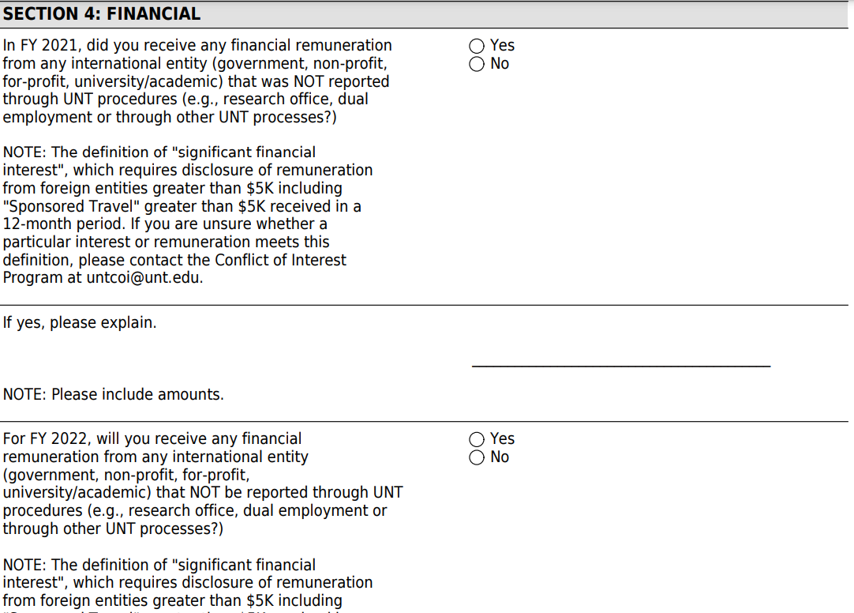
What do I need to disclose?
Financial
any financial remuneration from any international entity (government, non-profit, for-profit, university/academic) that was NOT reported through UNT procedures

Slide 10
What do I need to disclose?
Agreements & Contracts
Living allowances
Consulting
Honorariums
Summer contracts

Slide 11
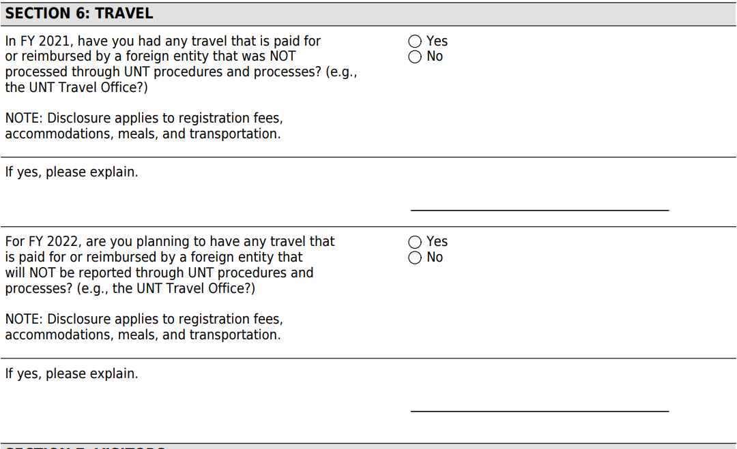
What do I need to disclose?
Travel
any travel that is paid for or reimbursed by a foreign entity that was NOT processed through UNT procedures and processes
Registration Fees
Accommodations
Meals
Transportation

Slide 12
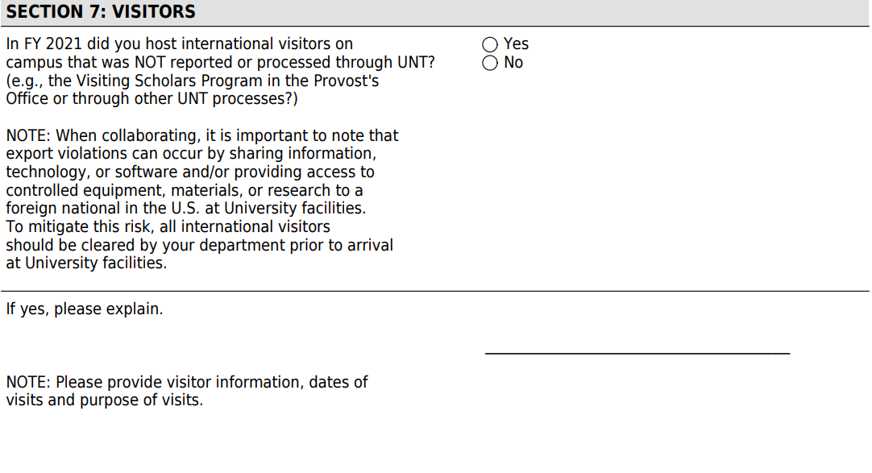
What do I need to disclose?
Visitors
Any visitors not part of Visiting Scholars Program
Providing access to:
Equipment
Materials
Research data
Technology/software

Slide 13
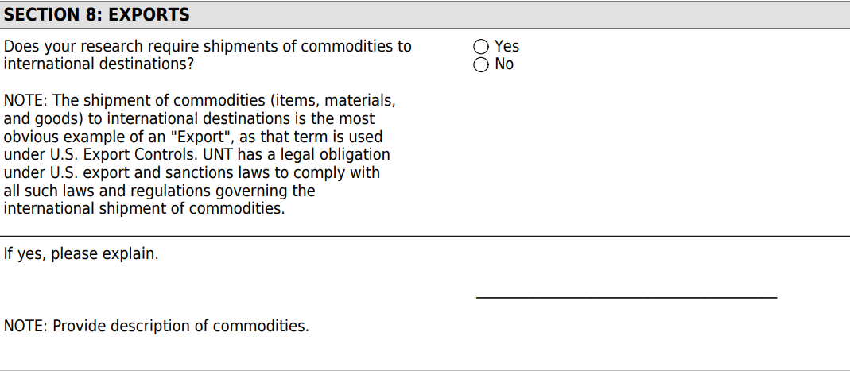
What do I need to disclose?
Exports
Shipment of commodities to international destinations
Export control concerns
Biosafety concerns

Slide 14
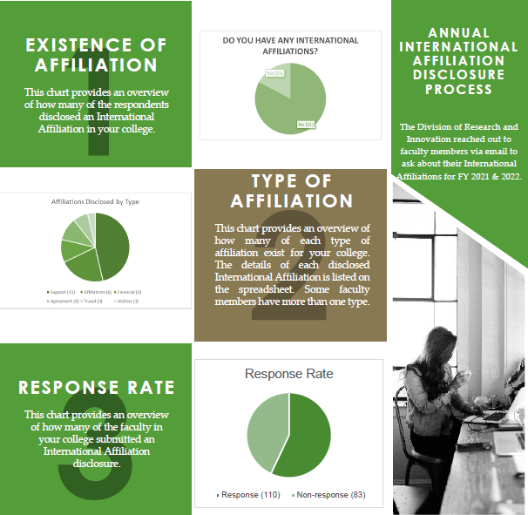
What happens to the information I share?
Securely stored via Azure
General reports to Deans
Completion rates
Categories
# of affiliations in each category
Best practice guidance

Slide 15
What if I already mentioned this?
Items on your IA Disclosure are often also listed on:
Research Conflict of Interest Disclosure (GRAMS/Qualtrics)
Dual Employment forms

Slide 16
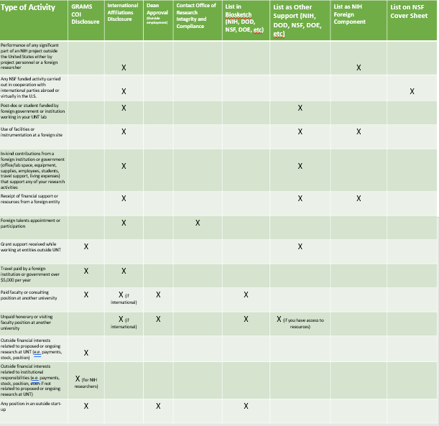
Relationship Disclosure Guidelines
Adapted from: https://ooc.usc.edu/wp-content/uploads/2020/06/Foreign-Relationships-Guidance-FINAL.pdf

Slide 17
Scenarios:
Performance of any significant part of an NIH project outside the United States either by project personnel or a foreign researcher.
UNT International Affiliations Disclosure
List as NIH Foreign Component

Slide 18
Scenarios:
Any NSF funded activity carried out in cooperation with international parties abroad or virtually in the U.S.
UNT International Affiliations Disclosure
List on NSF Cover Sheet

Slide 19
Scenarios:
Post-doc or student funded by foreign government or institution working in your UNT lab
UNT International Affiliations Disclosure
List as Other Support (NIH, DOD, NSF, DOE, etc)

Slide 20
Scenarios:
Use of facilities or instrumentation at a foreign site for an NIH project
UNT International Affiliations Disclosure
List as Other Support (NIH, DOD, NSF, DOE, etc)
List as NIH Foreign Component

Slide 21
Scenarios:
In-kind contributions from a foreign institution or government (office/lab space, equipment, supplies, employees, students, travel support, living expenses) that support any of your research activities.
UNT International Affiliations Disclosure
List as Other Support (NIH, DOD, NSF, DOE, etc)

Slide 22
Scenarios:
Receipt of financial support or resources from a foreign entity
UNT International Affiliations Disclosure
List as Other Support (NIH, DOD, NSF, DOE, etc)
List as NIH Foreign Component (if NIH study)

Slide 23
Scenarios:
Foreign talents appointment or participation
UNT International Affiliations Disclosure
Contact Office of Research Integrity and Compliance

Slide 24
Scenarios:
Grant support received while working at entities outside UNT
GRAMS COI Disclosure
List as Other Support (NIH, DOD, NSF, DOE, etc)

Slide 25
Scenarios:
Travel paid by a foreign institution or government UNT International Affiliations Disclosure
GRAMS COI Disclosure
UNT International Affiliations Disclosure

Slide 26
Scenarios:
Faculty or consulting position at another university
GRAMS COI Disclosure
UNT International Affiliations Disclosure (if international)
Dual Employment Form (UNTS HR)
List as Other Support (NIH, DOD, NSF, DOE, etc): if you have access to resources

Slide 27
Scenarios:
It’s complicated! Ask us!
This Photo by Unknown Author is licensed under CC BY-NC-ND

Slide 29
Questions?
THANK YOU!
Phone: 940-565-4643
Email: untcoi@unt.edu

