Slide 1




October 15, 2025
Export Control
Office of Research Integrity & Compliance
Presented by: Meg Cochran

Slide 2


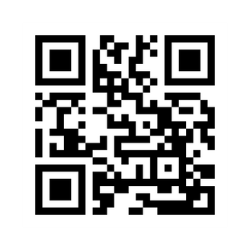
Division of Research and Innovation
Pam Padilla
Vice President for Research and Innovation
Autumn Pinckard
Sr. Director of Research Integrity and Compliance
Chris McMullen
Sr. Administrative Coordinator of Research Compliance
Sarah Romack
Director of Ethics & International Research Compliance
Dr. Veena Naik
BioSafety Officer
(IBC)
Dr. Imelda Norton
Research Lab Manager
(IACUC)
Meg Cochran
Research Security & Export Control Officer
Meg Cochran
Research Security & Export Control Officer
Daniel Bassett
Director
(IACUC, IRB)
Research Integrity Home Page
Joan Powers
Sr. Research Compliance Analyst (IRB)
Rodney Fernandez
Sr. Research Compliance Analyst (IRB)
Tracee Kelly
Research Compliance Analyst (IRB)

Slide 3
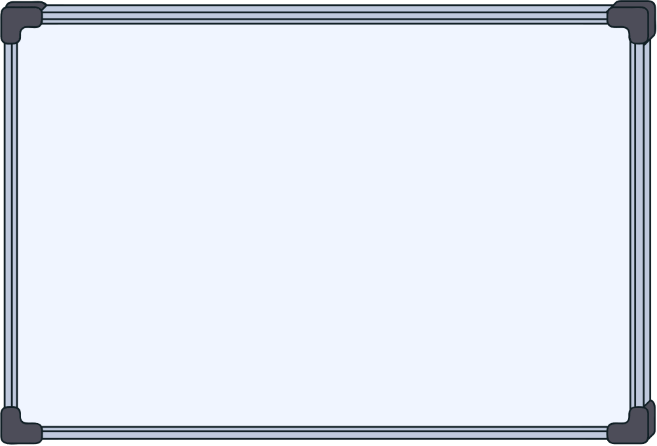



What we will Cover
Terms:
What is export control?
What is an export?
Fundamental Research Exclusion
Exclusions
ITAR definition
EAR definition
Deemed export risk
Consequences for violations
Export control at UNT
Insider threat
Resources

Slide 4

Terms
International Traffic in Arms Regulations (ITAR)
Directorate of Defense Trade Controls (DDTC) under Department of State (DoS)
United States Munitions List (USML)
Regulates the export of military grade services, software, and data.
Export Administration Regulations (EAR)
Bureau of Industry and Security (BIS) under Department of Commerce (DoC)
Export Control Classification Number (ECCN) –Specific category of controlled product
EAR99- Broader category for NLR goods
Regulates a broader range of items than ITAR, including commercial and Dual-use technologies
Office of Foreign Assets Control (OFAC)
Department of Treasury (DoT)
Specially Designated Nationals List (SDN)
Sanctions
Controlled Unclassified Information (CUI)
Information that does not meet the criteria for classification, but that still must be protected. CUI is information that is created or possessed by the US government or by other entities on its behalf.

Slide 5


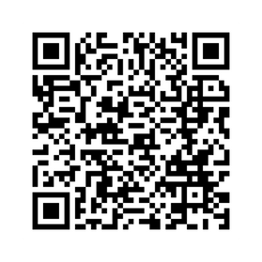
International Traffic in Arms Regulations
(ITAR)
Department of State, Directorate of Defense Trade Controls (DDTC)
Has primacy over all export regulations
Methods for exporting legally:
Export License
Agreement
Technical Assistance Agreement (TAA)
Exemption ( AKA: Waiver)
Example: Airbus agreed to settle 75 charges of violations of the ITAR by its subsidiaries (Jan 27, 2020).
- Omitted material facts regarding the payment of commissions, fees, or political contributions paid
- Unauthorized reexport of ITAR technology. Result: $10,000,000, fine.

Slide 6

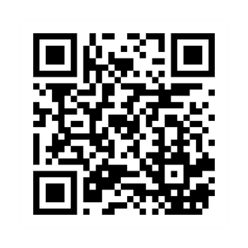
Export Administration Regulations (EAR)
Department of Commerce
Bureau of Industry and Security (BIS)
Methods for Exporting Legally
No License Required (NLR) – also applies to EU regulations
Export License
Exception (a.k.a. waiver)
EAR99 is a classification designation for an item that is subject to the EAR but not specifically described by an ECCN ( export control classification number) on the CCL (commerce control list). NLR, which stands for “No License Required,” is a shipment designation.

Slide 7

What is Export Control?
Export controls are a set of regulations that govern the transfer of controlled items or information to foreign nationals, countries, and entities.
Samples, substances, data, and information can all be considered exports.
Exporting something can mean sharing it with a foreign national.
Something DOES NOT HAVE TO LEAVE THE UNITED STATES to be considered a deemed export.
Export Controls are U.S. laws and regulations that regulate and restrict the release of critical U.S. technology, information, and training to foreign nationals, within the United States, and foreign countries for reasons of foreign policy and national security.

Slide 8


What is an Export?
Any item that is sent from the U.S. to a foreign destination
Sharing controlled technology/source code to a foreign national in the U.S. is a “deemed” export to the country of the foreign national.
Export includes items transferred to a U.S. subsidiary and/or U.S. government installation in a foreign country (such as a military base)
Methods of Export
Software uploaded to or downloaded from an Internet site
Mail, hand carried on a plane, fax
Technology discussed via email or during a phone conversation

Slide 9

Fundamental Research Exclusion
Fundamental Research Exclusion (FRE) is a federal government exemption that protects research information from export controls and allows universities to conduct research without licenses.
What it covers
The FRE applies to research information that could be publicly shared, including unclassified research. It does not apply to materials or items that are intended to be transferred or shipped internationally.
What it doesn't cover
The FRE doesn't apply to proprietary research or industrial development, design, production, and product utilization.
What it allows
The FRE allows universities to conduct research without licenses and allows foreign researchers to participate in basic research
Exclusions

Slide 10


Deemed Export Risk
What is a Deemed Export?
Any release of technology or source code subject to the EAR/ITAR to a foreign national
Such “release” is deemed to be an export to the home country or countries of the foreign national
What does “release” mean?
Visual inspection by foreign nationals of U.S.-origin equipment and facilities
Oral exchanges of information in the United States
The application of personal knowledge or technical experience acquired in the United States – i.e. training
What Technology?
All technology except:
Technology under the jurisdiction of another agency
Printed books
Publicly available technology
Technology that arises during or results from fundamental research

Slide 11
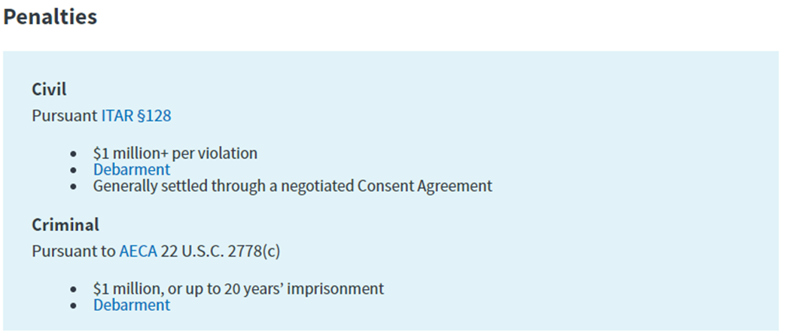

Consequences for Violations
Violations:
ITAR/EAR violations may result in civil and/or criminal penalties, including fines and debarment
The Directorate of Defense Trade Controls (DDTC)/Bureau of Industry & Security (BIS) is responsible for civil enforcement of the regulations, while the Department of Justice handles criminal matters.
Compliance oversight, and the loss of business opportunities.

Slide 12



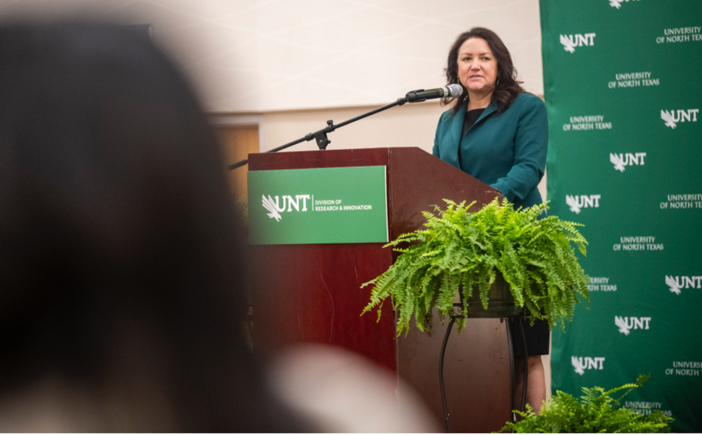
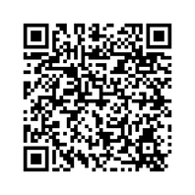
Export Control at UNT
Research Security and Export Control Officer in the Research Integrity and Compliance office of the Division of Research and Innovation.
International Travel Device Checklists:
Loaner laptops
Technology control plans
Export Control Training available- Live/ Recorded, CITI Modules
International Compliance Coordination Committee
Export Control works with International Risk Control Coordinator to ensure foreign travel is compliant with institutional and federal and state policy.
Quarterly and ad hoc meetings take place to discuss policy and other compliance issues.

Slide 13

Insider Threat Awareness
Insider Threat is the likelihood, risk, or potential that an insider will use his or her authorized access, wittingly or unwittingly, to do harm to the national security of the United States or to the institution.
Higher education institutions and their employees are a top target for foreign intelligence services that seek information regarding:
U.S. technologies
Federally funded research
Intellectual property
Classified or controlled unclassified information (CUI), (e.g., export‐controlled, proprietary, financial)
Other sensitive information that could lead to a military, technological, or economic advantage.

Slide 14

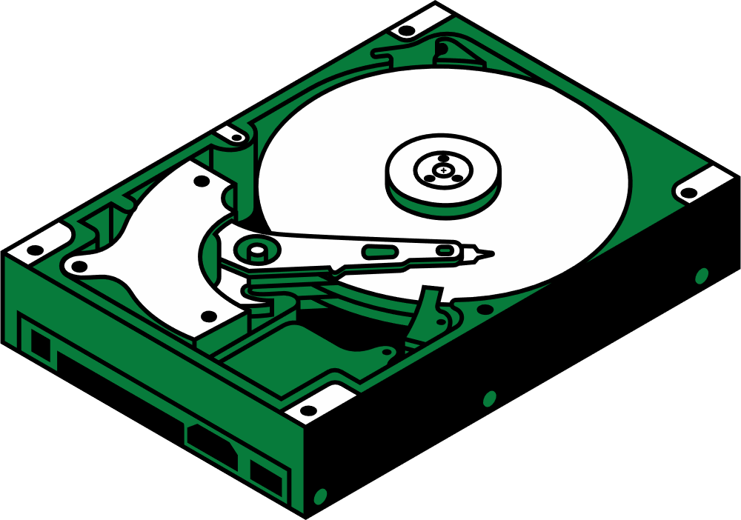
Information Collection
Keeping materials in an unauthorized location
Attempting to access information without authorization
Obtaining access to information inconsistent with duty requirements
Information Transmittal
Using an unauthorized medium to transmit sensitive materials
Discussing sensitive materials with people not authorized to access that information

Slide 15



Additional Suspicious Behaviors
Repeated or unrequired work outside of normal hours
Accessing protected areas/information after hours, at unusual times, repeated issues with locking secure areas, etc.
Sudden changes in financial situation
New debts/financial anxiety
Displays of wealth not congruent with type of employment
Attempts to conceal foreign travel
Unregistered trips
Unaccounted for absences

Slide 16


Stay alert to behavior and security measures for sensitive materials.
Share observations with supervisor or Export Control Officer.
If you see something, say something.
Reminders are OK, but do not confront someone if you have suspicions.
What Can I Do?

Slide 17



Questions?
THANK YOU!
Phone: 940-565-4658
Email: oric@unt.edu
Margaret.cochran@unt.edu

