Slide 1

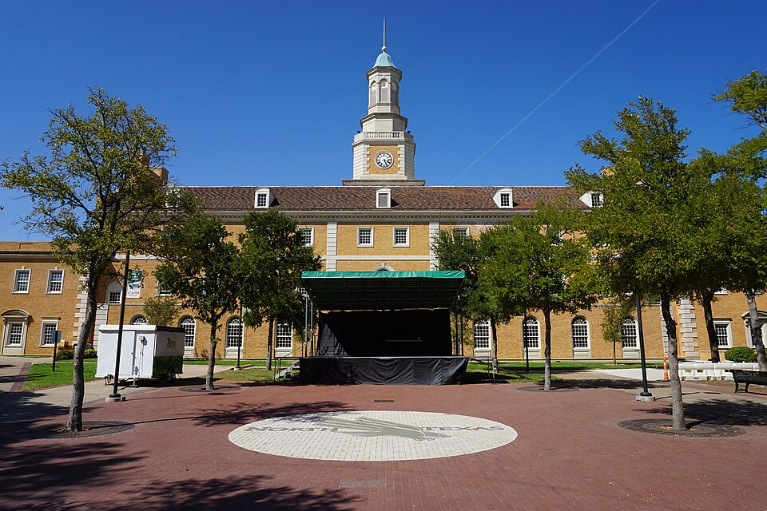

RESPONSIBLE CONDUCT OF RESEARCH
CONFLICT OF INTEREST & INTERNATIONAL AFFILIATIONS
Presented by: Sarah Romack
Date: 10/09/2025

Slide 2



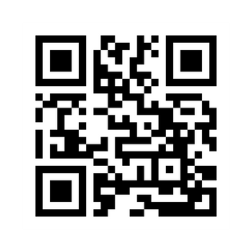
Division of Research and Innovation
Pam Padilla
Vice President for Research and Innovation
Autumn Pinckard
Sr. Director of Research Integrity and Compliance
Chris McMullen
Sr. Administrative Coordinator of Research Compliance
Sarah Romack
Director of Ethics & International Research Compliance
Dr. Veena Naik
BioSafety Officer
(IBC)
Dr. Imelda Norton
Research Lab Manager
(IACUC)
Meg Cochran
Research Security & Export Control Officer
Meg Cochran
Research Security & Export Control Officer
Daniel Bassett
Director
(IACUC, IRB)
Research Integrity Home Page
Joan Powers
Sr. Research Compliance Analyst (IRB)
Rodney Fernandez
Sr. Research Compliance Analyst (IRB)
Tracee Kelly
Research Compliance Analyst (IRB)

Slide 3


What are we Going to Talk About?
What is the goal of the Conflict of Interest Program
What is a COI? What is an SFI? What is an International Affiliation?
Why should you care about COI & International Affiliations
COI Filing Process
Management Plans
SBIRs/STTRs
Q&A

Slide 4

What is the Goal of a COI Program?
Promote objectivity in research
Support faculty entrepreneurship, support industry engagement
Meet sponsor, public, regulatory, and legal requirements
Preserve research integrity
Protect academic freedom
Protect human participants
Protect interests of students and staff

Slide 5

What is a Conflict of Interest?
A financial conflict of interest related to research exists when a financial interest – or other opportunity for personal financial gain – is likely to compromise or influence—or appear to compromise or influence—the objective design, conduct, reporting, or direct administration of research.
Conflicts are a set of intersecting relationships; they are not inherently bad, but they must be properly managed to protect the integrity of UNT research.

Slide 6

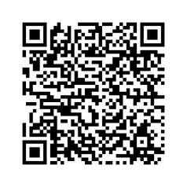

What is a Significant Financial Interest?
Examples of an SFI include:
Salary/Consulting Fee
Equity: stock, stock options, ownership
Income from Intellectual Property
Travel sponsored by outside agency
Report anything earned by the investigator, spouse, or dependent children.
Scan to Learn More!
This Photo by Unknown Author is licensed under CC BY-ND

Slide 7

What is a NOT a Significant Financial Interest?
Examples of non-SFI include:
UNT Salary or UNT-funded travel
Investments like Mutual Funds or Retirement Accounts
Investigator is not directly controlling the investment
Income from seminars/lectures sponsored by a government agency, college/university, teaching hospital, or research institute affiliated with college/university.
Income from advisory committee or review panel from government agency, college/university, teaching hospital, or research institute affiliated with college/university.

Slide 8
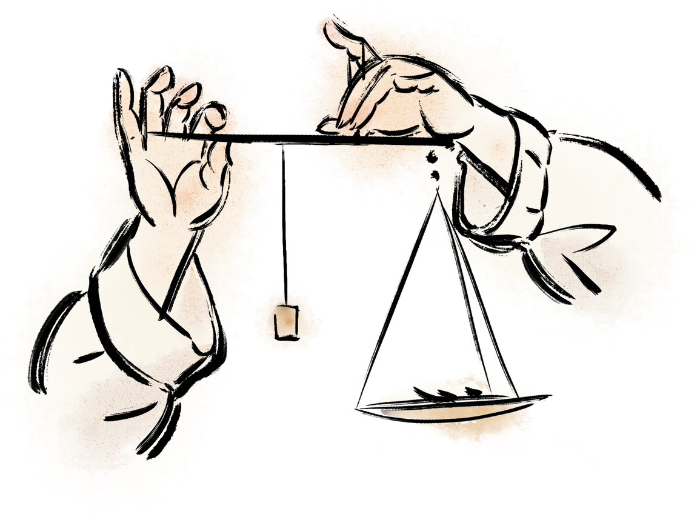

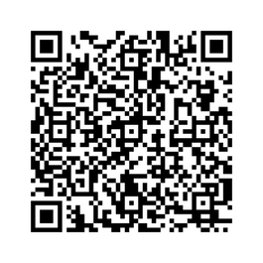
Why should you disclose COI/IA?
The Public may lose trust in the University
Loss of investigator/faculty member credibility in the academic community
Protection of human subjects and integrity of research may be compromised: Protect the science!
University may lose research funding
May 2024: The Cleveland Clinic settled for $7.6 million for allegations of violating the False Claims Act after a researcher failed to disclose international funding to the NIH
Submit a Disclosure

Slide 9

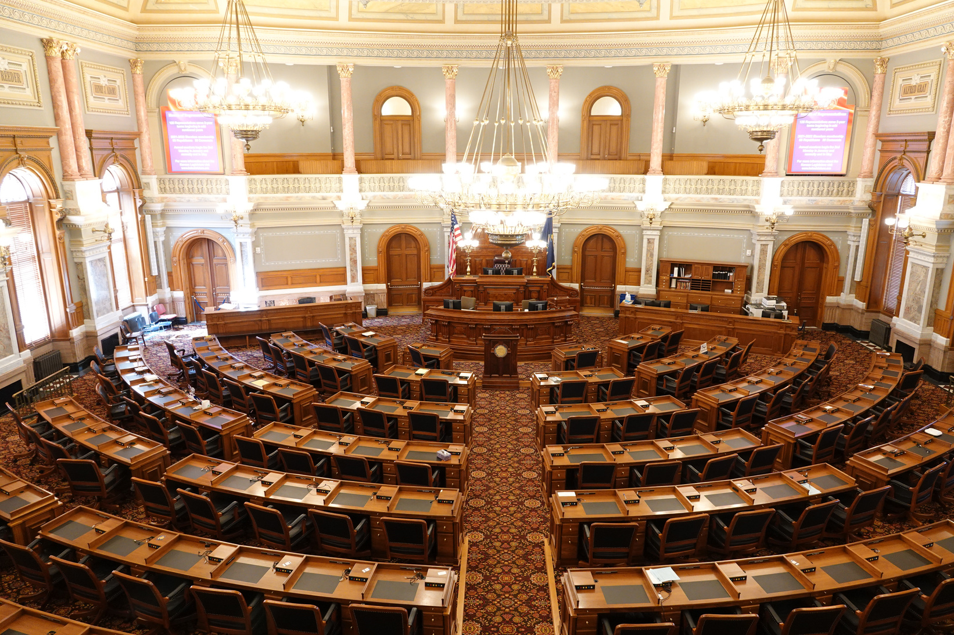
PHS Agencies
Agency for Healthcare Research and Quality (AHRQ)
Agency for Toxic Substances and Disease Registry (ATSDR)
Centers for Disease Control and Prevention (CDC)
Food and Drug Administration (FDA)
Health Resources and Services Administration (HRSA)
Indian Health Service (IHS)
National Institutes of Health (NIH)
Office of the Assistant Secretary for Health (OASH)
Office of the Assistant Secretary for Preparedness and Response (ASPR)
Office of Global Affairs (OG)
Substance Abuse and Mental Health Services Administration (SAMHSA)

Slide 10


PHS-Specific Requirements
PHS COI Training required before engaging in research & every 4 years. Also:
When UNT revises its financial conflict of interest policies or procedures in any manner that affects the requirements of Investigators;
When an Investigator is new to UNT; or
When UNT finds that an Investigator is not in compliance with UNT’s financial conflict of interest policy or procedures or management plan.
COI Policy must be:
Written & up-to-date
Available via publicly accessible website
ORIC office must:
Provide initial & ongoing reports to PHS about FCOI
Maintain records of disclosures for at least three years from the date the final expenditures report is submitted to the PHS or, where applicable, from other dates specified elsewhere in this procedure for different situations

Slide 11

COI Filing Process
Researchers (PI, co-PI, Key Personnel) must submit a COI Disclosure:
At the time of proposal
Annually thereafter
Within 30 days of a new Significant Financial Interest
COI Disclosure Review steps:
Disclosure submission
RIC office reviews
COI committee reviews
Collaborate with researchers on their management plans
Execute the management plan
This Photo by Unknown Author is licensed under CC BY-SA-NC
Submit a Disclosure

Slide 12
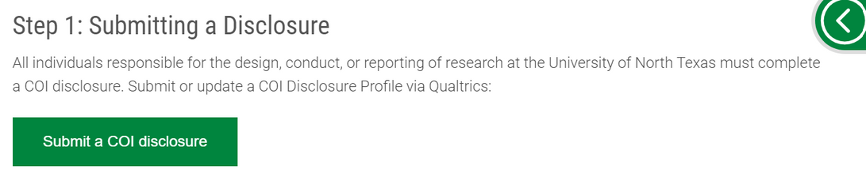

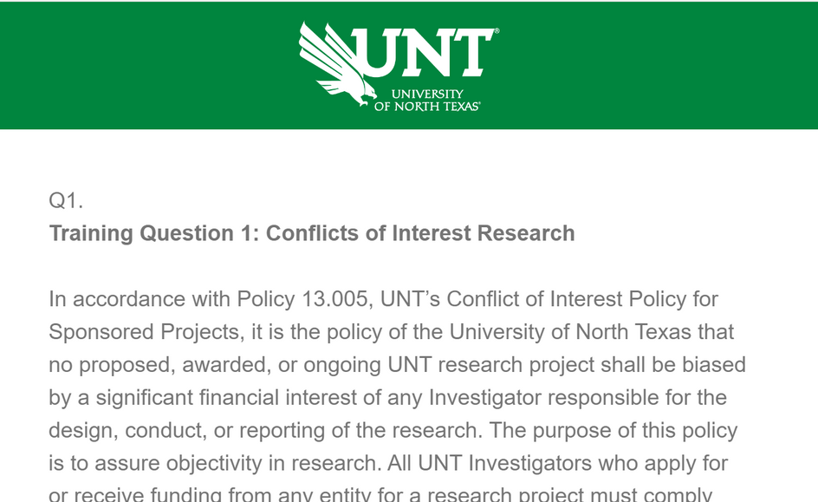
COI Step-by-Step in Qualtrics
On the UNT RIC COI website, click Submit a COI Disclosure.
2. You will submit via Qualtrics survey

Slide 13
PAPPG 24-1 MFTRP Certification
On February 19ᵗʰ, the NSF officially released the Proposal & Award Policies & Procedures Guide 24-1.
It went into effect on May 20, 2024
In anticipation, our office added a question about Malign Foreign Talent Recruitment Program on January 1, 2024
Prohibition of participation in a MFTRP is now part of UNT COI Policy 13.005

Slide 14
Malign Foreign Talent Recruitment Program
A Foreign/international talent recruitment program (FGTRP) is an effort organized, managed, or funded by a foreign government, or a foreign government instrumentality or entity, to recruit science and technology professionals or students (regardless of citizenship, national origin, or full-/part-time status).
Incentivizing/compensating the FGTRP participant to relocate physically to a foreign country in order to import/acquire the proprietary technology, software, etc.;
Allowing for or encouraging the FGTRP participant to receive U.S. Federal research funds while concurrently working at and/or receiving compensation from a foreign institution for the same, or similar, work;
Directing FGTRP participants not to disclose their participation to United States entities;
Compelling FGTRP participants to enter into contracts that conflict with their responsibilities to UNT, or that are disallowed by UNT
OFAC-sanctioned countries: Russia, Iran, China and North Korea

Slide 15

What else is new on the COI Disclosure?
Questions about:
paid or unpaid appointments, positions, or honors at an international academic institution
financial or in-kind support from an international entity (government, non-profit, academic)
international collaborators
travel (past year) or upcoming travel that will be paid for or reimbursed by an international entity
What is done with this information?
Restricted Party Screenings
Dynamic screenings are run daily (If a collaborator/institution appears, our office will contact you)
Checking award/contract terms
Why is this being asked?
By including this information in the COI Disclosure form, we will no longer require the annual International Affiliations disclosure.

Slide 16

What is an International Affiliation?
Giving a talk internationally
Sharing data or materials
Collaborating on a research project
Hosting international students or scholars
Accepting an overseas appointment

Slide 17

How are International Affiliations impacted by GA-48?
International collaborations are still allowed:
Collaborators on the entity list are not allowed
Project-specific requirements must be considered
Visiting Scholars (current and future) are allowed.
No business travel to China, North Korea, Cuba, Iran & Russia
Personal travel to China, North Korea, Cuba, Iran & Russia must be registered
Complete the pre- and post-travel forms with Risk Management.

Slide 18

COI Review Process
Research Integrity & Compliance Office Review
Conflict of Interest Committee Review
Management Plan Creation & Follow-up
COI Management Plans:
Outline the nature of the Significant Financial Interest
Discuss data protection & storage
Identify other faculty & students involved with project
Name an Oversight Committee
Outline stipulations for purchasing
Are reviewed on an annual basis
Are shared with agency & prime awardee as requested
This Photo by Unknown Author is licensed under CC BY

Slide 19
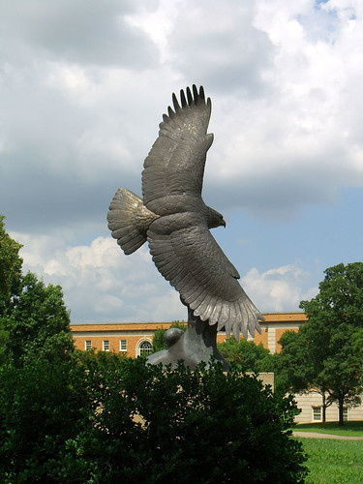
Managing Conflicts
This Photo by Unknown Author is licensed under CC BY-SA
Disclosure statements in journals/presentations
Student Acknowledgement forms
Modification of the Research Plan
Change of personnel or responsibilities
Reduction or elimination of financial interest
Severance of ties that create financial conflict

Slide 20

Small Business Innovation Research (SBIR) & Small Business Technology Transfer (STTR)
Programs administered by US Small Business Association
Funding source for start-ups & small businesses
Goals:
Stimulate technological innovation
Use small business to meet Federal R&D needs
Encourage socially/economically disadvantaged and women-owned businesses
Increase private sector commercialization
This Photo by Unknown Author is licensed under CC BY

Slide 21
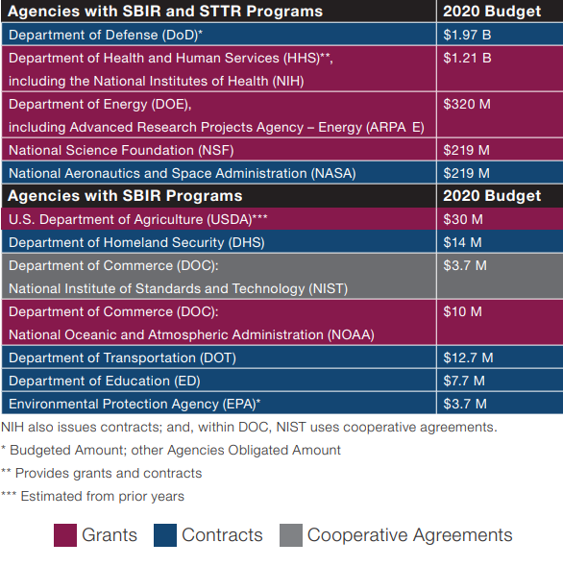
Small Business Innovation Research (SBIR) &
Small Business Technology Transfer (STTR)
Eligibility:
Small firm (<500 employees)
At least 51% US-owned
PI must be employed by the firm
NIH allows co-PIs
During Phase I/II, 30% of the research was subcontracted to a university or federal lab
How are these handled at UNT?
COI Management Plan
Work with the Research Commercial Agreements Office

Slide 22
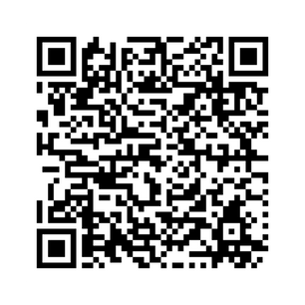
COI Resources (on our website!)
UNT’s COI Policy
2011 PHS Conflict of Interest Regulations, 42 CFR Part 50, Subpart F
NIH Conflict of Interest Page
NIH FAQs
Summary of Major Changes from 1995 to 2011 COI Regulations
DOE Interim Conflict of Interest Policy

Slide 23




UPCOMING RCR WORKSHOPS
October 15th - Export Control
Novemberᵗʰ – Animal Research & Biosafety

Slide 24

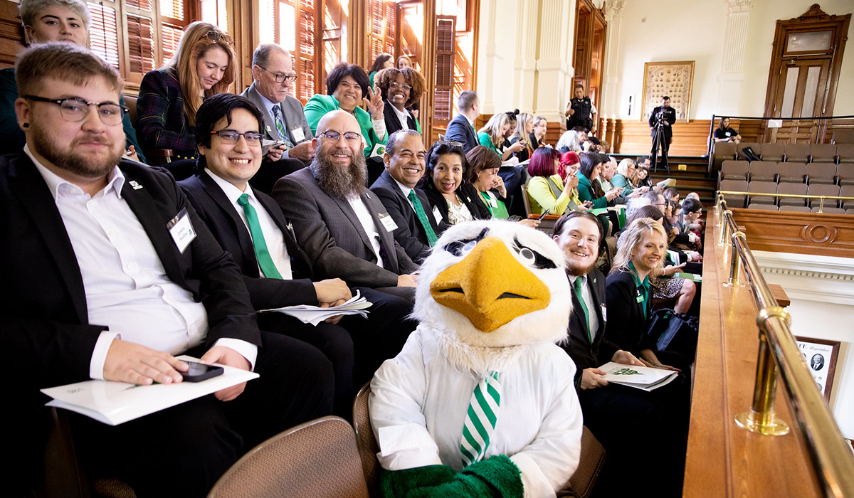
QUESTIONS?
THANK YOU!
PhonE: 940-565-4643
EMAIL: UNTCOI@UNT.EDU

