Slide 1
Export Control at UNT
Office of Research Integrity & Compliance

Slide 2
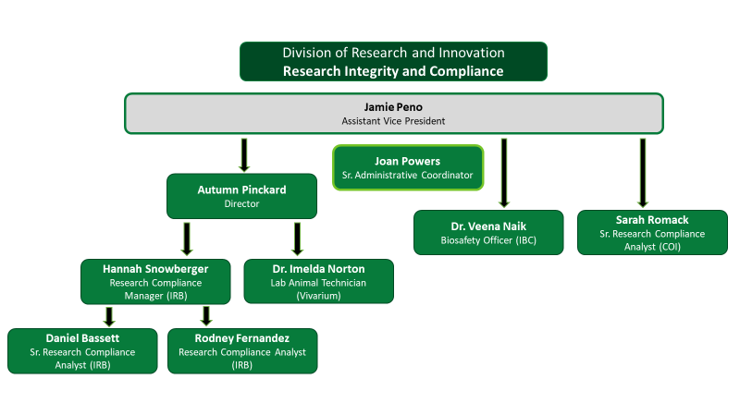
Division of
Research and Innovation
Research Integrity and Compliance
Jamie Peno
Assistant Vice President- RIC
IRB
COI
IACUC
Export Control
RCR
Christina Cantu
Sr. Administrative Associate
Hannah Snowberger
Sr. Research Compliance Analyst
Autumn Pinckard
Research Compliance Manager
Sarah Romack
Research Compliance Analyst
IRB
IRB
IACUC
COI
Operations

Slide 3
What we will Cover:
Terms
What is export control?
What is an export?
Fundamental Research Exclusion
Exclusions
ITAR definition
EAR definition
Deemed export risk
Consequences for violations
Export control at UNT
Resources

Slide 4
Terms
International Traffic in Arms Regulations (ITAR)
Directorate of Defense Trade Controls (DDTC) under Department of State (DoS)
United States Munitions List (USML)
Regulates the export of military grade services, software, and data.
Export Administration Regulations (EAR)
Bureau of Industry and Security (BIS) under Department of Commerce (DoC)
Export Control Classification Number (ECCN) –Specific category of controlled product
EAR99- Broader category for NLR goods
Regulates a broader range of items than ITAR, including commercial and Dual-use technologies
Office of Foreign Assets Control (OFAC)
Department of Treasury (DoT)
Specially Designated Nationals List (SDN)
Sanctions
Controlled Unclassified Information (CUI)
Information that does not meet the criteria for classification, but that still must be protected. CUI is information that is created or possessed by the US government or by other entities on its behalf.

Slide 5
International Traffic in Arms Regulations (ITAR)
Department of State, Directorate of Defense Trade Controls (DDTC)
Has primacy over all export regulations
Methods for exporting legally:
Export License
Agreement
Technical Assistance Agreement (TAA)
Exemption ( AKA: Waiver)
Example: Airbus agreed to settle 75 charges of violations of the ITAR by its subsidiaries. Jan 27, 2020
- Omitted material facts regarding the payment of commissions, fees, or political contributions paid
- Unauthorized reexport of ITAR technology. Result: $10,000,000, fine

Slide 6
Export Administration Regulations (EAR)
Department of Commerce
Bureau of Industry and Security (BIS)
Methods for Exporting Legally
No License Required (NLR) – also applies to EU regulations
Export License
Exception (a.k.a. waiver)
Example: Nordic Maritime Pte. Ltd. (Nordic), and its Chairman, Morten Innhaug
(Innhaug) – March 11, 2020
Illegal reexport of controlled undersea surveying equipment to Iran for use in surveying an Iranian oil field
Result:
Denying the export privileges of both Nordic and Innhaug for 15 years
$31,425,760 civil monetary penalty

Slide 7
What is Export Control?
Export controls are a set of regulations that govern the transfer of controlled items or information to foreign nationals, countries, and entities.
Samples, substances, data, and information can all be considered exports.
Exporting something can mean sharing it with a foreign national.
Something DOES NOT HAVE TO LEAVE THE UNITED STATES to be considered a deemed export.
Export Controls are U.S. laws and regulations that regulate and restrict the release of critical U.S. technology, information, and training to foreign nationals, within the United States, and foreign countries for reasons of foreign policy and national security.

Slide 8
What is an Export?
Any item that is sent from the U.S. to a foreign destination
Sharing controlled technology/source code to a foreign national in the U.S. is a “deemed” export to the country of the foreign national.
Export includes items transferred to a U.S. subsidiary and/or U.S. government installation in a foreign country (such as a military base)
Methods of Export
Software uploaded to or downloaded from an Internet site
Mail, hand carried on a plane, fax
Technology discussed via email or during a phone conversation

Slide 9
Fundamental Research Exclusion
Fundamental Research Exclusion (FRE) is a federal government exemption that protects research information from export controls and allows universities to conduct research without licenses.
What it covers
The FRE applies to research information that could be publicly shared, including unclassified research. It does not apply to materials or items that are intended to be transferred or shipped internationally.
What it doesn't cover
The FRE doesn't apply to proprietary research or industrial development, design, production, and product utilization.
What it allows
The FRE allows universities to conduct research without licenses and allows foreign researchers to participate in basic research

Slide 10
Exclusions
What is required to be considered fundamental research:
Be basic or applied research in engineering or science
Be conducted within the United States
Have no publication restrictions other than a limited review
Have no sponsor restrictions on the nationality of personnel who can be involved in the research
Must be public domain or on track to be public domain

Slide 11
Deemed Export Risk
What is a Deemed Export?
Any release of technology or source code subject to the EAR/ITAR to a foreign national
Such release is deemed to be an export to the home country or countries of the foreign national
What does “release” mean?
Visual inspection by foreign nationals of U.S.-origin equipment and facilities
Oral exchanges of information in the United States
The application of personal knowledge or technical experience acquired in the United States – i.e. training
What Technology?
All technology except:
Technology under the jurisdiction of another agency
Printed books
Publicly available technology
Technology that arises during or results from fundamental research

Slide 12
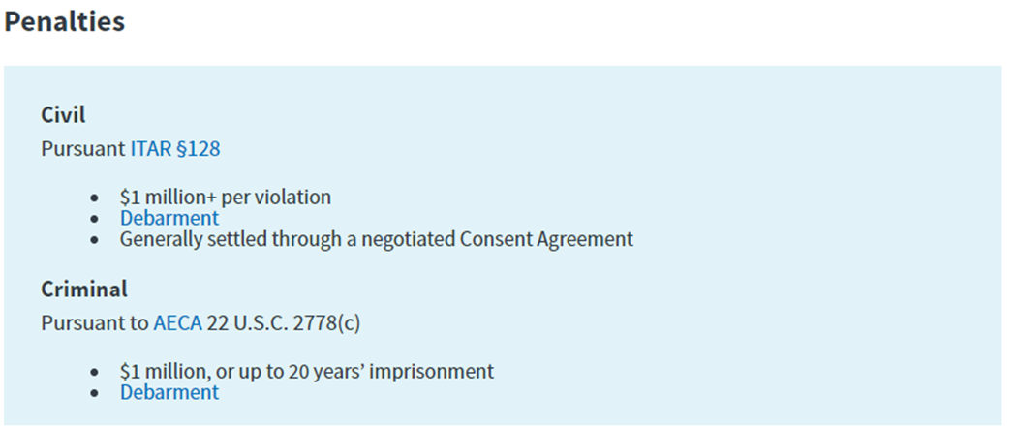
Consequences for Violations
Violations
ITAR/EAR violations may result in civil and/or criminal penalties, including fines and debarment
The Directorate of Defense Trade Controls (DDTC)/Bureau of Industry & Security (BIS) is responsible for civil enforcement of the regulations, while the Department of Justice handles criminal matters.
Compliance oversight, and the loss of business opportunities.

Slide 13
Export Control at UNT
Research Security and Export Control Officer in the Research Integrity and Compliance office of the Division of Research and Innovation.
International Travel Device Checklists
Export Control works with International Risk Control Coordinator to ensure foreign travel is compliant with institutional and federal policy
Loaner Laptops
Technology Control plans
Export Control Training available- Live/ Recorded, CITI Modules
International Compliance Coordination Committee
Quarterly and ad hoc meetings take place to discuss policy and other compliance issues

Slide 14
Questions?
THANK YOU!
Phone: 940-565-4658
Email: oric@unt.edu
Margaret.cochran@unt.edu

