Slide 1
Responsible Conduct of Research
Animal Research and Biosafety
Nov 11, 2024, at 2 PM

Slide 2
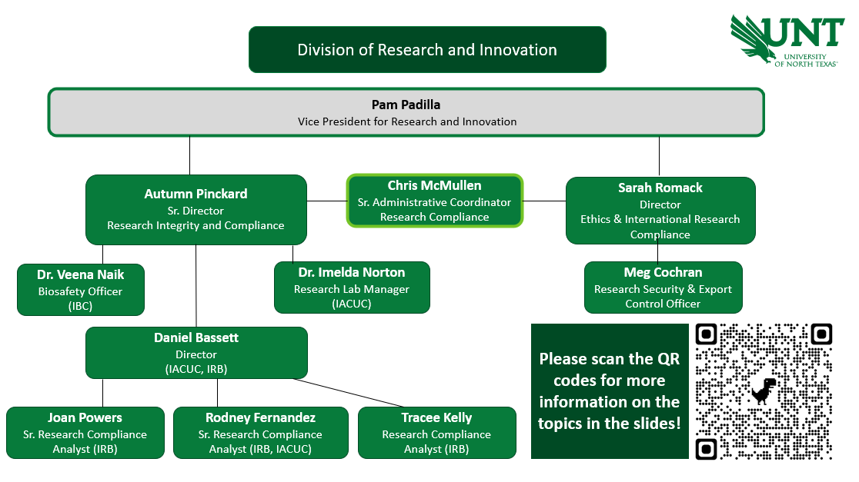

Slide 3
The Institutional Animal Care and Use Committee (IACUC)
Who
The IACUC must have at least five voting members of specific and varying backgrounds in order to provide complete and adequate review of animal related research. The Committee will also include at least one member from the local community, who is not affiliated with the institution and one member who is not a scientist. Our committee also includes our UNT Biosafety Officer.
What
Responsible for approving all research involving animals or animal tissues prior to study initiation at UNT. This includes field studies that are performed by UNT faculty, staff, or students off campus.
Why
The IACUC is concerned with protecting the welfare of animals and researchers by assuring research activities are being conducted per institutional policies and federal guidelines.
Notes:
A Veterinarian, a Research Scientist, a Non-Scientist, a Community Member

Slide 4
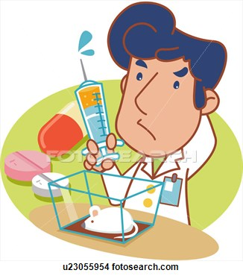



Why do we need an IACUC?
1.To protect and ensure the humane care and judicious use of animals in research.
2.To protect the health and welfare of those working with research animals and their environments.
    Replacement
    Reduction
    Refinement
  Ensures measures are taken to inform and protect those that come into contact with research animals from health and safety hazards such as zoonotic diseases, risks of injury such as a bite, etc.
Notes:
Replacement=alternatives to animal use (technology, simulations) *ultimate goal
Reduction=w/o affecting experiment (ex. tissue sharing as long as there were not drugs already used on that tissue)
Refine= providing better environment and in turn improving research results (ex. animals not under stress will have more natural responses)

Slide 5
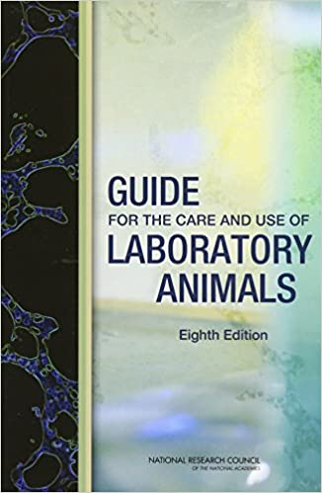
The Regulations
The USDA
  The Animal Welfare Act is the only federal law that regulates the treatment of animals in research, exhibition, transport, and by dealers.
  Other laws, policies, and guidelines may include additional species coverage or specifications for animal care and use, but all refer to the Animal Welfare Act as the minimum acceptable standard. The Act is enforced by USDA, APHIS, Animal Care.
  Enforces Public Health Services Policy (PHS)
  The University of North Texas provides a programmatic Assurance to OLAW that is renewed with program changes and every 5 years. An annual update is submitted each year under said Assurance to OLAW.
  UNT PHS Assurance #D16-00485/ A3841-01
  Requires that assured institutions base their programs of animal care and use on The Guide and comply with all USDA regulations.
The National Institutes of Health (NIH) Office of Laboratory Animal Welfare (OLAW)

Slide 6
Other Regulations
The AVMA
    provides guidance in relieving pain and suffering of animals to members of the veterinary profession who carry out or oversee the euthanasia of animals.
The FDA
  provides regulations that pertain to non-clinical laboratory studies using animals in support of Good Laboratory Practices (GLP) applications for research or marketing permits for products that are regulated by FDA.
UNT Policies and Procedures
Regulations of other UNT Research & Safety Committees
  ie., Radiation Safety, Laser Safety, EHS, RMS, etc.
  Institutional Biosafety Committee
IACUC
IBC
IRB
Note: you may be required to obtain approvals from other UNT Research and Safety Committees based on your protocol prior to IACUC approval. No other committee can approve your use of animals at UNT!
Notes:
The UNT IACUC requires that methods of euthanasia in animal research protocols be a method approved by the AVMA for each species.

Slide 7

Health & Safety
Occupational Health for Animal Workers Annual Enrollment
Reporting of Incidents and Bites
  All research team members and employees that may encounter animals or animal tissue in their work at UNT should enroll in the Occupational Health and Safety for Animal Workers Program.
  All research team members that may encounter animals or animal tissues related to a UNT research project or UNT research animal, are required to report all personnel incidents (including animal scratches and bites) to RMS and the UNT IACUC office immediately.
  Should enroll annually by submitting a Health Questionnaire online to be reviewed by a UNT Physician.
  Record of a recent tetanus shot is required for those working with animals or animal tissues at UNT.
  Services are offered through Student Health Services on campus, 3rd party, or through a PCP. (Principal Investigators should be advised that any costs associated with Occ Health Requirements will fall to them)
  PIs and Lab Managers are responsible for following the reporting procedures outlined in the IACUC SOP.
  If an animal bite occurs, UNT Veterinary Staff will evaluate the need for animal quarantine and will establish and recommend procedures for such.
  IACUC Report Form should be used and is found on our IACUC webpages and through RMS.
Notes:
Research Protocols have Emergency contacts on front pg and should already be readily accessible in your lab and to all your personnel

Slide 8
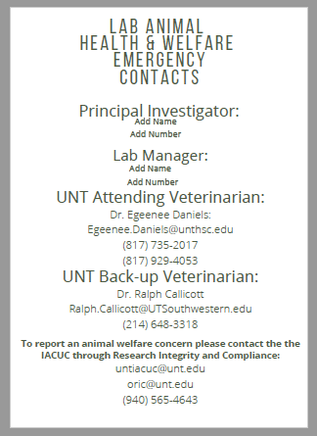
Welfare Reporting
Unanticipated Adverse Events
Animal Welfare Concerns
  Any happening that is not consistent with routinely expected outcomes that result in any unexpected animal welfare issues (death, disease, or distress) or human health risks (zoonotic disease or injuries).
  UNT is committed to the humane and ethical treatment of animals. In the case of emergencies or to report concerns related to the care and use of animals, animal health, or environmental conditions, please contact us immediately.
  It is the responsibility of the Principal Investigators, and Lab Animal Staff to ensure the IACUC and Attending Veterinarian are informed in a timely matter of all Adverse and/or Unanticipated Events that occur under an approved Animal Use Protocol.
  Report adverse events or unanticipated outcomes directly to IACUC by completing an IACUC Form 14- Unanticipated Adverse Event Form and emailing it to untiacuc@unt.edu.
  Reporting to external agencies may be necessary depending on the type of event and method of funding for the study.
  Individual(s) reporting concerns do not have to identify themselves, and the University will, to the maximum extent possible, protect the privacy of those who report concerns.
  All reports will be referred to the UNT Denton IACUC for review and, if warranted, investigated to determine the appropriate corrective actions needed.
  All PIs should have IACUC Approved Contact Signage visibly posted *inside* all animal lab areas.
Notes:
Research Protocols have Emergency contacts on front pg and should already be readily accessible in your lab and to all your personnel

Slide 9
Protocol Review Process:
UNT Faculty/PI must submit an IACUC Animal Use Protocol (AUP) for the IACUC committee to review and approve their research project before working with animals. Submissions (AUPs, annual renewals, modifications, closures, 3yr renewals) will be reviewed in the order they are received. The committee will review submissions through a process called Designated Review, Full Committee Review, or Veterinary Verification and Consultation. Protocols require annual renewals and full renewal prior to their 3yr expiration date.
Committee reviewers assign one of four possible outcomes
Approved as written
Approved with contingency(s)
Tabled pending modification and review by entire committee
Rejected
Committee has no concerns regarding the submission as reviewed.
Work may begin immediately.
Few or minor issues with the protocol. Committee proposes conditions necessary for approval.
PI makes any suggested changes in writing and resubmits for Admin/Chair approval.
Letter of contingent approval will be provided. Once conditions are satisfied, full approval will be given and work may begin.
Moderate concerns raised or concerns requiring further clarification.
PI must modify protocol and resubmit for full committee review at next meeting.
No work may begin
Significant concerns raised with key components of proposed research.
No work may begin, and resubmission of the protocol is not allowed.

Slide 10
Submitting an Animal Use Protocol
Tools for successful submission
*these should all be completed PRIOR to your protocol submission to the IACUC.
Review appropriate UNT IACUC Policies and Procedures.
Ensure key personnel have completed required trainings and Occ. Health Screening.
Ensure appropriate housing plans are in place.
Consult with the UNT Veterinarian for analgesia/ anesthesia plans.
Consult with appropriate Safety, Biosafety and/or IBC personnel.

Slide 11
Biosafety and
Institutional Biosafety Committee (IBC)

Slide 12






UNT BIOSAFETY OFFICE
Manage -
1
BIOSAFETY AND BIOSECURITY PROGRAM
Biosafety Office
IBC
2
INSTITUTIONAL BIOSAFETY COMMITTEE
3
Training - In-person, virtual or via CITI Platform,
4
Research and Teaching Laboratory Safety Audits (RMS collaboration)
Respond to Accident and Incidents, Follow-up & Reporting
5
Spills/
Accidents
6
Research Non-compliance inquiries

Slide 13


Biosafety and Biosecurity
1
Biohazard
Biohazards include biological agents and toxins that have the potential to cause disease in humans, animals, plants and can cause significant damage to the environment. (e.g. - parasites, viruses, bacteria, fungi, prions etc.; and biologically-active materials such as toxins, allergens, and venoms)
2
Biosafety
Framework that describes the use of specific practices, training, safety equipment, administrative controls and lab designs to contain and protect the researchers, community, and environment from an accidental exposure or unintentional release of infectious agents and toxins.
UNT has only BLS1 and BSL2 level labs
3
Biosecurity
Is to ensure the safe use and security of biological materials used in laboratories. Biosecurity focuses on protecting biological agents from theft, loss, or misuse.

Slide 14
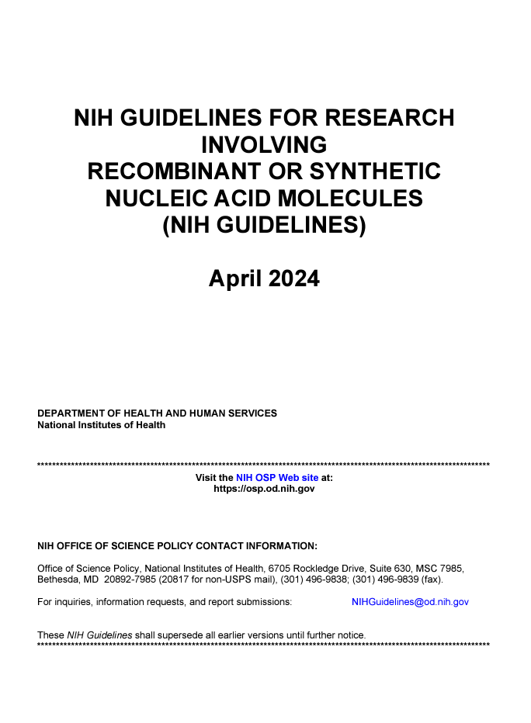
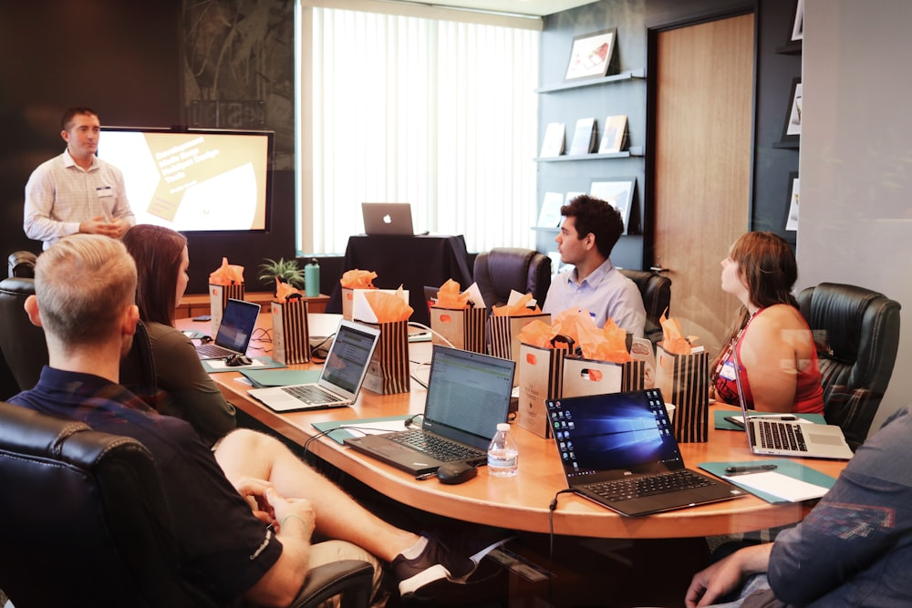
The Institutional Biosafety Committee (IBC):
Compliance with the NIH Guidelines and is mandatory as a condition of receiving NIH funding for such research.
IBC is established to provide guidance and promote the safe conduct of research involving biohazardous materials.
Non-compliance – funds to the institute may be suspended, limited, or terminated.
Why
Who
The IBC must have a Biosafety Officer and at least five voting members with specific
The Committee should include at least two members from the local community, who are not affiliated with the institution.
Responsible for reviewing, approving and overseeing research involving the use of recombinant or synthetic DNA/RNA and use of biohazardous materials - in research and teaching labs.
Incident Reporting : Any significant problems, violations, or any significant research-related accidents and illnesses” be reported by the PI or BSO to OSP within 30 days.
What

Slide 15
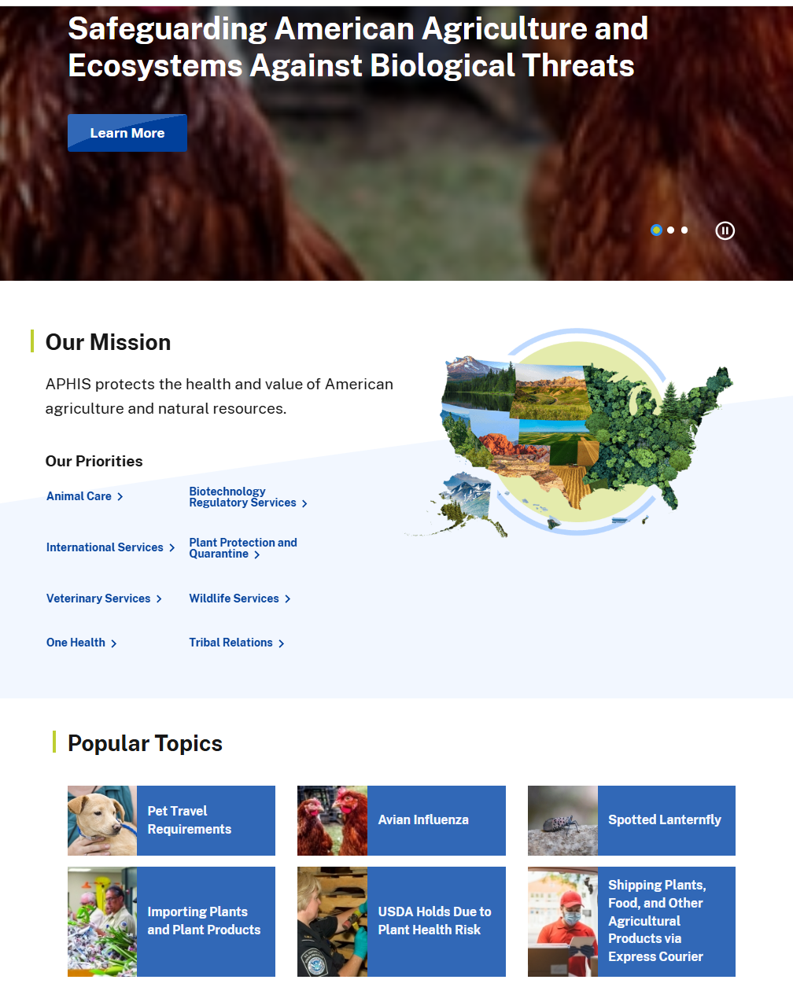
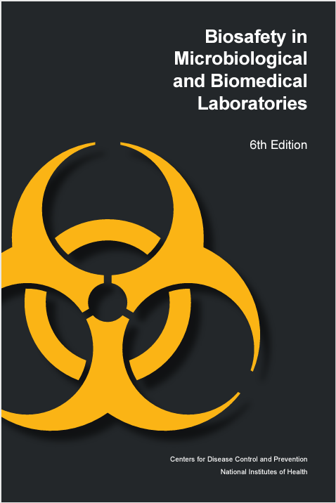
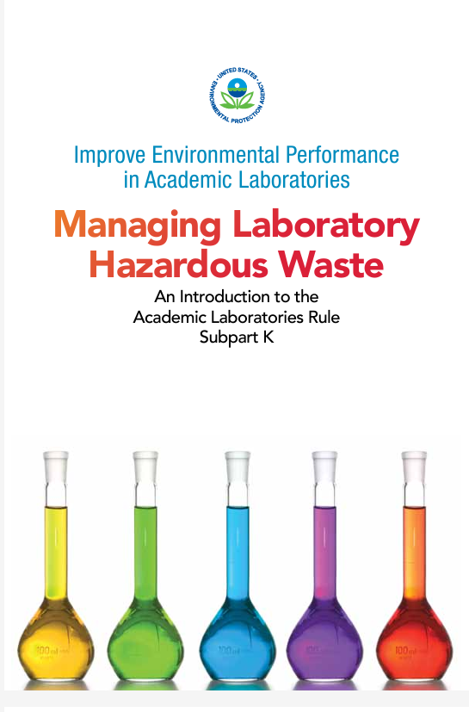
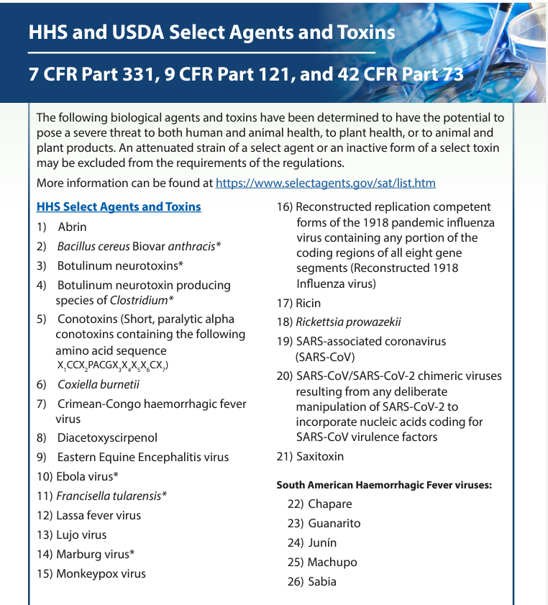
IBC Purview
  According to NIH - IBC responsibilities “need not be restricted to recombinant research”, UNT IBC also reviews projects on:
Infectious agents
Animals – vertebrate or non vertebrates
Dead animals or animal derived materials
human studies and human derive materials
Nano- technology
Select Agents and Toxins
Arthropods
In vitro studies
Plant Research
Zoonotic diseases
Regulations that govern the purchase, use, handling and disposal of biohazardous material
Notes:
The UNT IACUC requires that methods of euthanasia in animal research protocols be a method approved by the AVMA for each species.

Slide 16
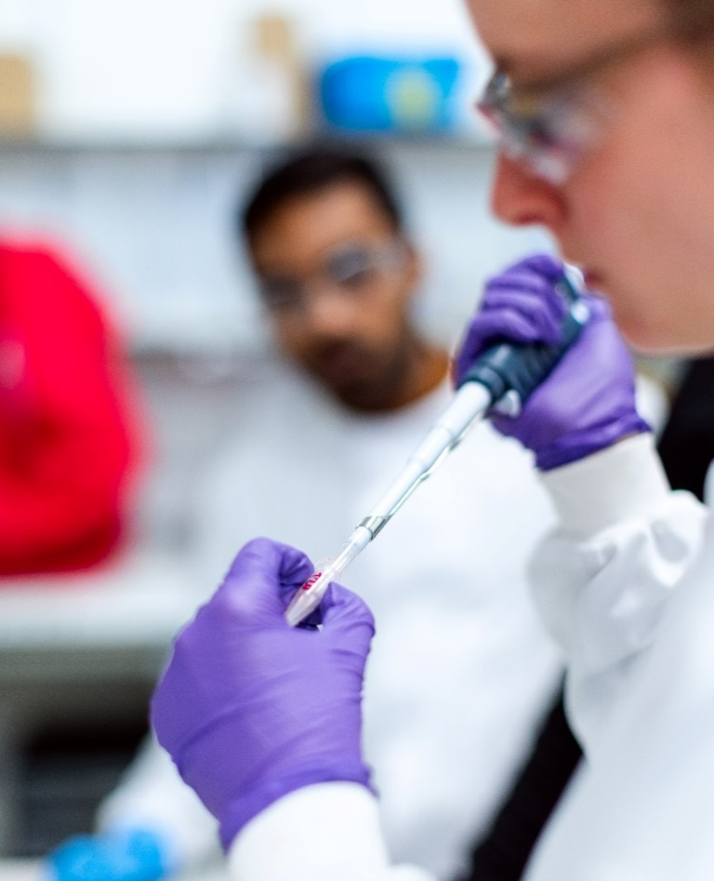
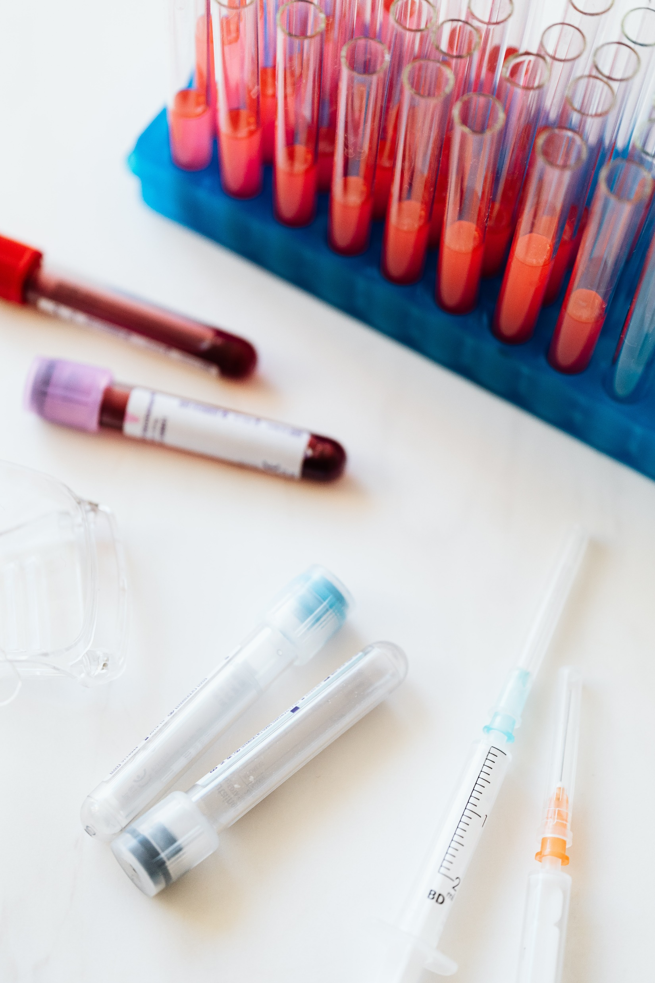
LAI & Routes OF Exposure to Biohazards
A laboratory-acquired infection (LAI) is any infection that occurs from exposure to a biological agent during laboratory-related activities.
Inhalation
Procedures that produce aerosols
Inoculation
Needlestick
Ingestion
Splashing to the face,
Contact with skin and mucous membrane
Splashes
Laceration from sharp objects (injury due to blades, scissors, broken glass)
Animal bite and scratch
Contact with contaminated fomites
Entry through broken/ cracked skin
placing contaminated objects in mouth,
Eating/drinking in the space
(changing cages, handling bedding materials, pipetting, mixing )
Notes:
The UNT IACUC requires that methods of euthanasia in animal research protocols be a method approved by the AVMA for each species.

Slide 17

Training
  All Biosafety related training is now available via CITI Program
  Initial Biosafety Training
  Personal Protective Equipment
  Animal Biosafety (if working with animals)
  OSHA Bloodborne Pathogens (if working with human derived samples)
  NIH Recombinant DNA Guidelines (if working with recombinant DNA materials)
  Nanotechnology (if working with nano materials)
  Emergency and Incident Response to Biohazard Spills and Releases
  Laboratory Specific Training - PI
  Develop and Follow Standard Operating Procedure (SOP) - PI
  Biosafety Retraining (Annual Retraining)
Standard Operating Procedures
SOP for mice treatment
Shedding, cage change, PPE, sample collection, dissection, carcass disposal
Treatment in drinking water, injection, gavage etc.
Notes:
The UNT IACUC requires that methods of euthanasia in animal research protocols be a method approved by the AVMA for each species.

Slide 18
IBC New Protocol Registration and Approval Process
Protocol Review Process:
Faculty/PI must submit the IBC New Protocol Registration Form for the IBC committee to review and approve their research project before working with these materials.
Committee meets once ever month (2nd Wed) – review and vote on the protocol and supporting documents
All new and resubmission is reviewed by the entire committee.
Committee votes to assign one of four possible outcomes -
Approved as written
Approved with contingency(s)
Tabled pending modification and review by entire committee
Rejected
Committee has no concerns regarding the protocol
Work may begin immediately
Few or minor issues with the protocol. Committee proposes conditions necessary for approval
PI makes suggested changes in writing., resubmits to BSO/Chair
IBC has no concerns. Work may begin
Significant concerned raised with key components of proposed research or inconsistent information (e.g., BSL3 level work in BSL2 lab)
No work may begin, and resubmission of the protocol is not allowed.
Moderate concerns raised or concerns requiring further clarification. Protocol not modified as suggested by IBC
PI must modify protocol and resubmit for full committee review at next meeting.
No work may begin
All approved protocols are valid for 3 years.

Slide 19
Renewals and Amendments
Annual Renewals are required on the anniversary date of the protocol approval.
Post Approval Monitoring is every 6 months or can be unannounced lab inspections
Minor changes to the protocol – PI should submit an IBC Protocol Amendment Form
Major changes – PI must submit an IBC New Protocol Form
Closeout – PI must submit an IBC Closeout Form at the end of their research

Slide 20
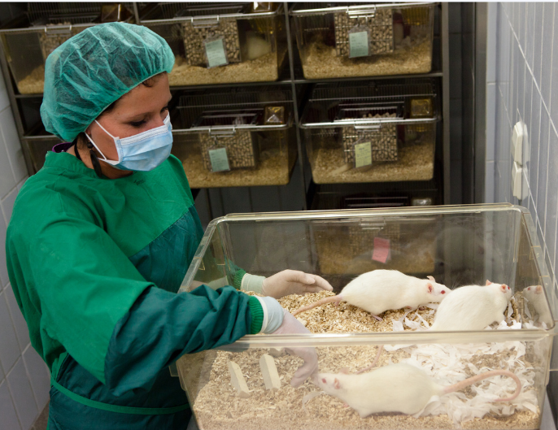
Comparing IACUC and IBC Review
IACUC Review (Federal, state, local, institutional regulations)
Animal welfare of live animals Pain and distress (behavioral, anatomical and physiological abnormalities) Risks to other animals in the facility from the inadvertent spread of vectors Scientific Merit and the three ‘R’ Training Concentrates mostly on live animals and may need minor paperwork for tissue use.
IBC Review (Federal, state, local, institutional regulations)
All types of animal research (vertebrates and non vertebrates) and animal derived materials (live, dead, cell lines etc. - in vivo and in vitro studies). Breeding of transgenic animals. Research for conformity with the NIH Guidelines for work with recombinant/ Synthetic Nucleic Acid Ways to mitigate/control risk to personnel - UNT Community and environment (HVAC, waste management, shedding, cage changes etc.) SOPs, procedures on proper handling of research material PI and other personnel training – related to BSL and ABSL and the research materials to be used. Risks to the environment (biggest concern) Escape and establishment in the wild Interbreeding with wild stock Consumption by other animals – enter the food chain Special consideration : Research involving animal tissues/organs/body fluids of zoonotic importance Training and waste disposal - safe handling of the biohazardous materials and the waste disposal
|20

Slide 21
Case Scenarios

Slide 22
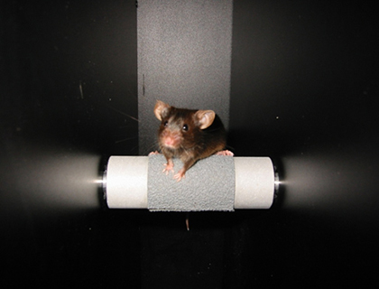
Case scenario - 1
Live laboratory animal study – without the use of any type of biohazardous material (e.g., Behavioral studies)
Laboratory animals from reputed vendor only
IACUC Approval only
Image source: UNC
Notes:
Sensory tasks, open field study, maze – water maze, or rotarod, grip strength etc.

Slide 23
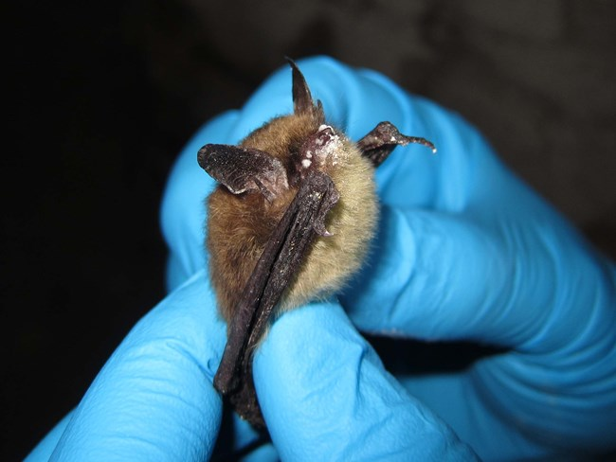
Case scenario - 2
Live animal study – without the use of any type of biohazardous material – but animal of zoonotic importance
IACUC Approval
IBC approval
Photo courtesy of Steve Taylor / University of Illinois (CC BY 2.0)
Notes:
Sensory tasks, open field study, maze – water maze, or rotarod, grip strength etc.

Slide 24
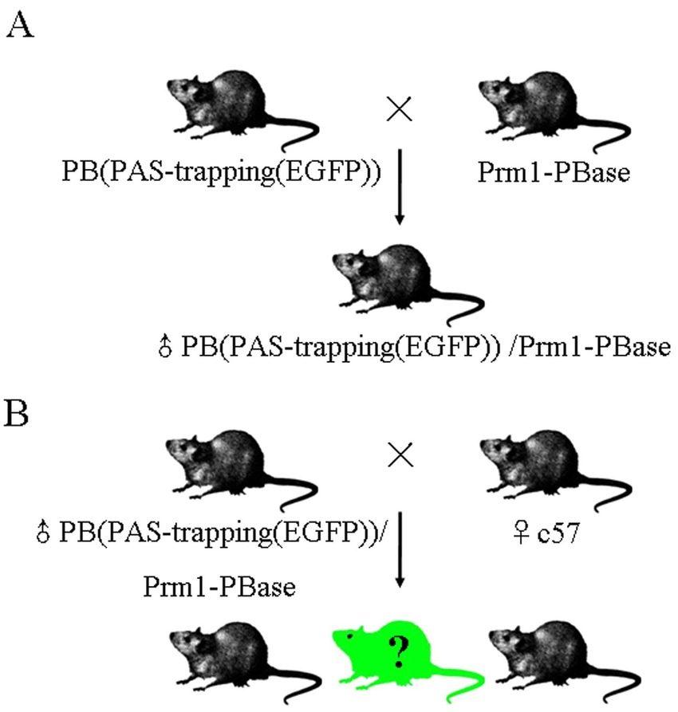
Case scenario - 3
Live Genetically Modified Animal study
IACUC Approval
IBC Approval
Image source: UNC
Image: Scientific Reports 6(1):27788
Notes:
Sensory tasks, open field study, maze – water maze, or rotarod, grip strength etc.

Slide 25
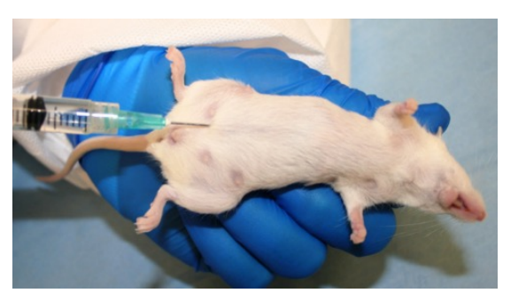
Case scenario - 4
Live Animal study with the use of any type of biohazardous material (genetically modified materials, pathogens, arthropods etc.) via any route of exposure.
IACUC Approval
IBC Approval
Image source: Virginia Tech, SOP: Mouse Intraperitoneal Injection

Slide 26
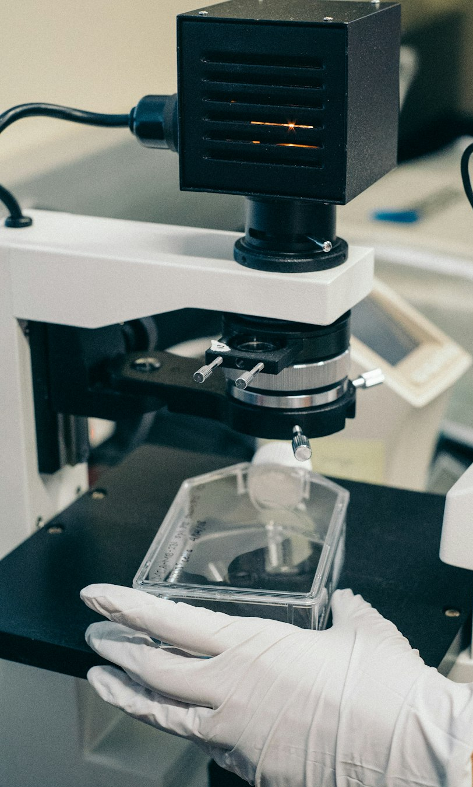
Case scenario - 5
Dead animals or animal tissue use for in vitro study (viral vectors, pathogens, arthropods etc.).
IACUC Approval
Submit a ‘Tissue Use Form’ only if collecting tissue from an animal (Primary cell lines)
IBC Approval
If working with cell lines purchased from a vendor (ATCC) you don’t need an IACUC approval

Slide 27
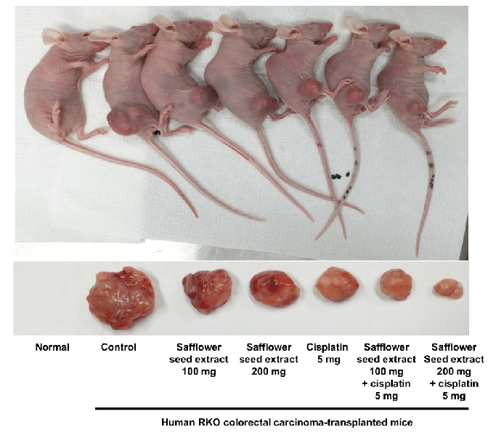
Case scenario - 6
Live Animal study - includes human cancer cell lines or any type of Xenotransplantation study
IACUC Approval
IBC Approval
If samples were collected from live human subjects
RMS approval if – if Radiation or chemotherapeutics are involved
If NO (ATCC) – IRB not required
If Yes, - IRB Required (Primary Cells)
Image Source: Safflower seed extract synergizes the therapeutic effect of cisplatin and reduces cisplatin-induced nephrotoxicity in human colorectal carcinoma RKO cells and RKO-transplanted mice. Drug Discoveries & Therapeutics, 13

Slide 28
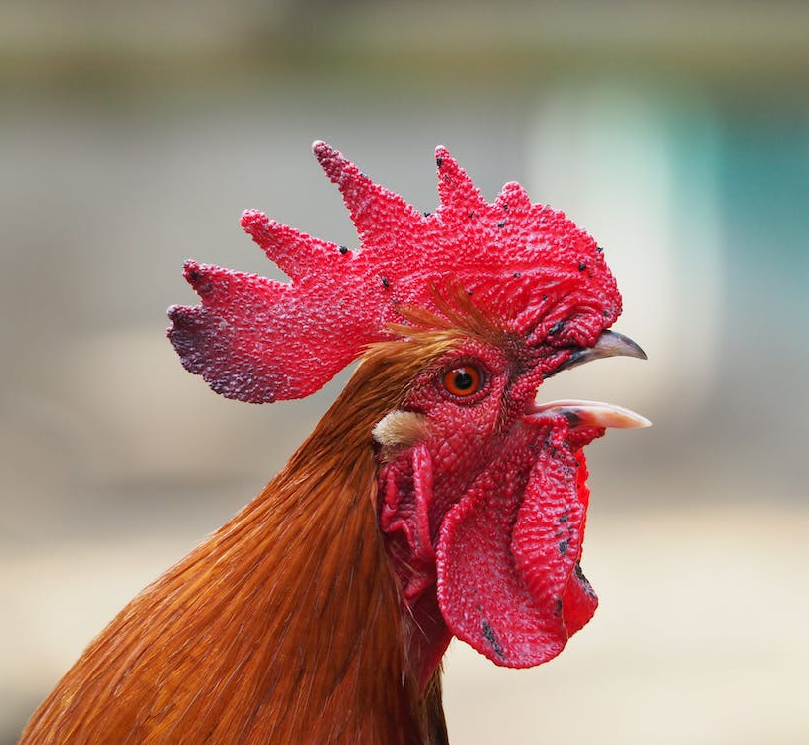
Case scenario - 7
who you gonna call?
untiacuc@unt.edu
ibcprogramm@unt.edu
veena.naik@unt.edu
Too many moving parts
Not sure
Notes:
Animal research – cancer cell lines, engineered cells line/gene therapy (recombinant viral vectors), chemotherapeutics, X-ray machine…. Radiation Safety, Laser Safety, EHS, RMS, etc. MTAs will be required for transfer of materials.

Slide 29
Support
Support/ Questions
IACUC
Autumn Pinckard
Imelda Norton
untiacuc@unt.edu
IBC
Veena Naik
IBCprogram@unt.edu | veena.naik@unt.edu
Thank you!

