Slide 1
Responsible Conduct of Research
IRB Overview, Responsible Recruitment and Elements Of Informed Consent
September 25, 2024
Notes:
Speaker: Dan

Slide 2
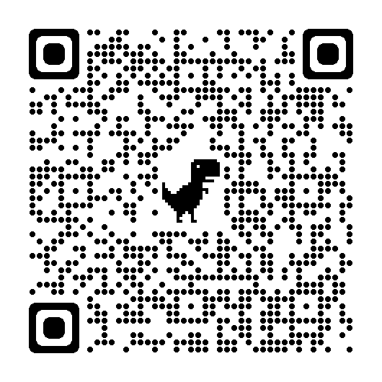
Division of Research and Innovation
Pam Padilla
Vice President for Research and Innovation
Autumn Pinckard
Sr. Director
Research Integrity and Compliance
Chris McMullen
Sr. Administrative Coordinator
Research Compliance
Sarah Romack
Director
Ethics & International Research Compliance
Dr. Veena Naik
Biosafety Officer (IBC)
Dr. Imelda Norton
Research Lab Manager
(IACUC)
Meg Cochran
Research Security & Export Control Officer
Daniel Bassett
Director
(IACUC, IRB)
Please scan the QR codes for more information on the topics in the slides!
Joan Powers
Sr. Research Compliance Analyst (IRB)
Rodney Fernandez
Sr. Research Compliance Analyst (IRB, IACUC)
Tracee Kelly
Research Compliance Analyst (IRB)

Slide 3
IRB Overview
“An administrative body established to protect the rights and welfare of research subjects recruited to participate in research activities conducted under the oversight of the institution with which it is affiliated.”
Notes:
Speaker: Dan

Slide 4

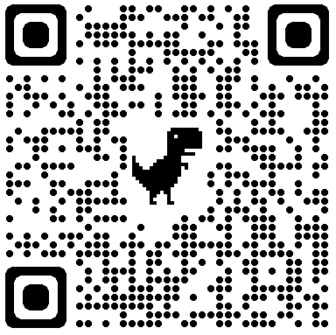
The Regulations
45 CFR 46- Common Rule
  Federal regulations that govern Human Subjects Research
  Provides guidance in the protection of the rights, welfare, and wellbeing of human subjects involved in research conducted or supported by the U.S. Department of Health and Human Services (HHS)
Department of Health and Human Services
  Office for Human Research Protections (OHRP)
The Declaration of Helsinki (1964)
  World Medical Association
  Ethical principles for medical research involving human subjects
The Belmont Report (1979)
  National Commission
  Three key ethical principals that form the ethical foundation for federal regulations
    Respect for persons
    Beneficence
    Justice
Notes:
Speaker:
Notes: 1. Respect: protecting the autonomy of all people and obtaining informed consent 2. Beneficence: maximizing benefits of the research while minimizing risks of harm to the research subjects 3. Justice: ensuring fair recruitment of subjects

Slide 5
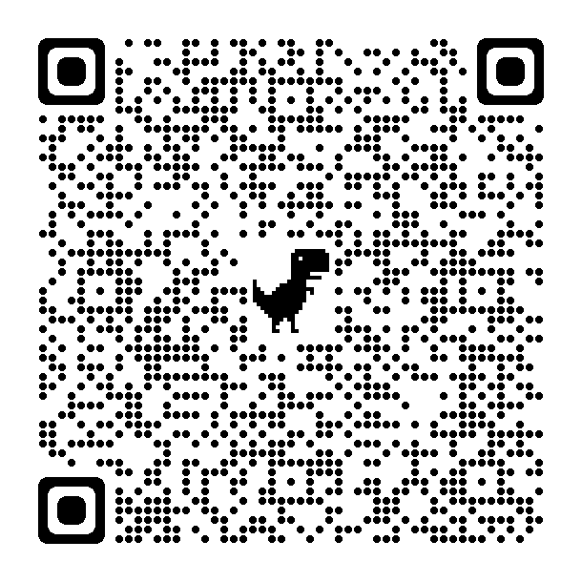
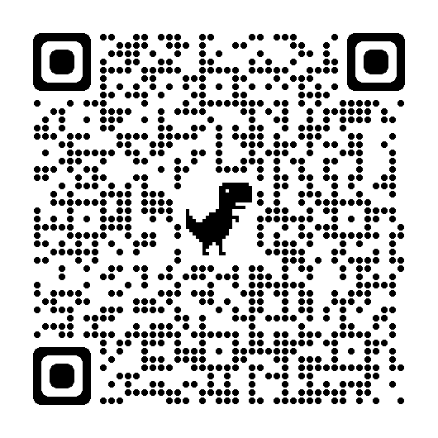
Institutional Review Board (IRB)
“Does my work with Human Subjects require review at UNT?”
Research
1
The systematic investigation, including research development, testing and evaluation, designed to develop or contribute to generalizable knowledge.
Submit an HSR Determination
request to get a
formal letter from the IRB!
2
Human Subject
A living individual about whom an investigator conducting research obtains data through the intervention, or interaction with the individual or their identifiable private information.
If the answer is YES, submit for review through Cayuse!
Access Cayuse through this QR Code!
3
Cayuse Access
To get access to Cayuse Human Ethics submission portal, submit access request form: https://research.unt.edu/cayuse-access-access-change-request

Slide 6

Institutional Review Board (IRB)
“Who can be a Principal Investigator on an IRB at UNT?”
Principal Investigators (and Co-PI’s) must be:
  A Full-time UNT faculty member
  A Full-time staff employee whose job responsibilities include conducting human subjects research
Cannot be:
  A Student
  A Lecturer*
  An Adjunct Instructor*
*May provide a letter or email from your Department Chair that acknowledges your research endeavors.
"Scientist" by stavos is licensed under CC BY-NC-ND 2.0

Slide 7

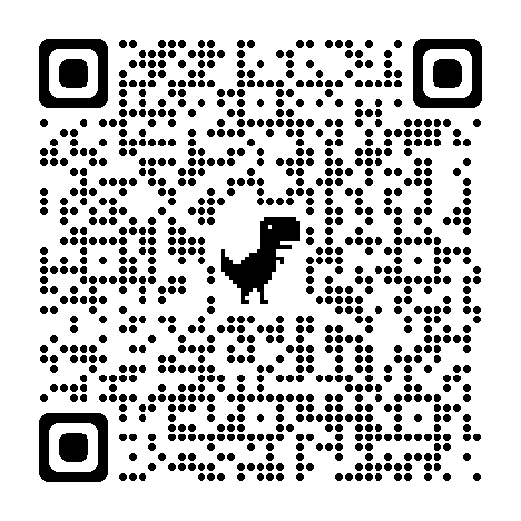
Institutional Review Board (IRB)
“How can I prepare my study for IRB submission?”
Plan ahead!
Timeline will depend on the volume of submissions received by the IRB office.
Protocols that are incomplete or lack details will be returned.
Gather all your attachments.
Informed Consent Forms/Alteration of informed consent
Surveys/Questionnaires, interview scripts, and intervention protocols.
CITI Training Certificates – Renew every 3 years
  Social Behavioral/Biomedical/RCR
Scope of work for any proposal for internal or external funding for the study.
Recruitment Materials
Please use our
UNT IRB
templates and guides!
This Photo by Unknown Author is licensed under CC BY-ND

Slide 8
Institutional Review Board (IRB)
“What does the IRB review process entail?”
IRB submissions are reviewed in the order that they are received.
Check the status of your protocol in the Cayuse IRB System from your Cayuse Dashboard.
Analyst Pre-Review
Respond
Review
Approval Documents
Research Compliance Analysts will conduct an initial review.
If revisions are needed, we will return the study to you in the Cayuse IRB System for edits.
Please complete the revisions in their entirety ASAP and resubmit the revised documents within the Cayuse IRB System.
Based on the risk of your study, you will be assigned a review category by the Research Compliance Analyst or Board Member:
Exempt :: Minimal Risk :: Reviewed and approved within the Compliance Office.
Expedited :: Sent to a secondary reviewer (IRB Board Member) for final review and approval.
Full Board :: Reviewed by the IRB Members at a monthly meeting:: Requires annual renewal.
Once you have satisfied all necessary requirements, and approval is issued, we will:
Email study contacts a copy of the Approval Letter
Attach your stamped informed consent document to your Cayuse IRB Study

Slide 9
My study is approved! What else do I need to worry about?
Modifications:
  Any changes to your final approved study must be approved by the IRB
  Submit a modification form before you implement any changes (i.e. adding key personnel, increasing recruitment, changes in study procedures, etc.)
Continuing Reviews:
  Full Board studies MUST be renewed each year before it is set to expire.
  Exempt and Expedited studies do not expire
Reportable Events:
  Any adverse effects, unanticipated problems, and protocol deviations or errors must be reported to our office.
Notes:
Speaker:

Slide 10
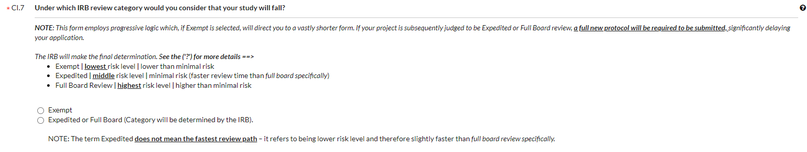

Protocol Submission:
Which Review Category do I need?
  Exempt study review:
  Research must be considered lower than minimal risk and
  does NOT involve:
  Vulnerable populations.
  Public disclosure of any identifiable data which places participants at risk.
  Audio-recording or video-recording* of the participants.
      *(Does not apply to recordings made for the purpose of transcription)
  Sensitive subject matter.
  Obtaining individually identifiable information protected under HIPAA.
  Typically DOES involve the following data collection procedures.
      Surveys.
      Educational tests.
      Interviews.
      Observation of public behavior.
  Expedited Review Category:
  To qualify for review at an Expedited level, the study must be no more than minimal risk.
  Examples include:
  Collection of data from voice, video, digital or image recording made for research purposes.
  Studies of existing pathological specimens with patient identifiers.
  Collection of a relatively small amount of blood/biological samples.
  Collection of data using minimal risk physical sensors.
Notes:
Speaker: Rodney
Verbal Consent: Used in circumstances where cultural differences may not allow for participants to sign (study with natives who believed signing documents gave undue power over someone else).

Slide 11
Recruitment Best Practices
Common recruitment methods
Things to be mindful of
Recruitment Templates/Examples
Notes:
Speaker: Hannah

Slide 12







Methods of Recruitment
Email
Listservs
Personal Contacts
Provided by an outside source
Flyers
Public vs. private
Social Media (Personal vs. Managed)
Facebook
X
Reddit
Instagram
Crowdsourcing
MTurk
SONA
Survey Monkey
Snowball Sampling
In person announcement/presentations
Direct Recruitment (Face to face)
Things to keep in mind
    Participant demographics:
    Are your recruitment methods going to reach a representative sample?
    Translated Documents for Non-English-Speaking Participants
    Documents must be made available in the participant’s primary spoken language
    Avoiding coercion and undue influence in recruiting:
    Where there is an imbalance of power, there is the potential for undue influence or coercion
    Student emails:
    Not available at UNT – only from listservs currently available to the researcher
    Vulnerable Populations
    Federally defined but not limited to as children, prisoners, people with intellectual disabilities

Slide 13

Obtaining Permission
Areas where permission is required:
Admins of Social Media groups
  Ex: Facebook groups, subReddits, Discord servers, chats, private servers, etc.
Email Listservs not already available to the research team
Private businesses/organizations
Other universities or schools including K-12
Permission is generally NOT required for recruitment through:
Public spaces – e.g. notice boards
A researcher’s personal social media accounts
Contacting people whose information is publicly available
This Photo by Unknown Author is licensed under CC BY-NC
Notes:
Speaker: Hannah

Slide 14

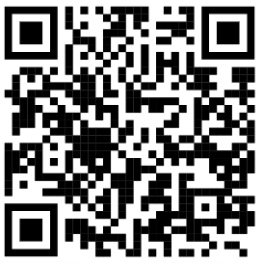
ResearchMatch
ResearchMatch is only available to be used for Health-related research studies.
ResearchMatch is a national registry of patients interested in volunteering for medical research. Anyone can register with ResearchMatch – even healthy volunteers.
This can be a great tool to use if you are looking to recruit participants for a health-related project.
If you are interested in learning about health-related research, YOU can sign up as a volunteer!
Notes:
Speaker: Rodney
Online platform for researchers to send a recruitment message to any Reserachmatch volunteer who meets their inclusion criteria

Slide 15
Informed Consent 101
Required Elements of Informed Consent
Documenting consent
Resources available to UNT Investigators
Notes:
Speaker: Rodney

Slide 16
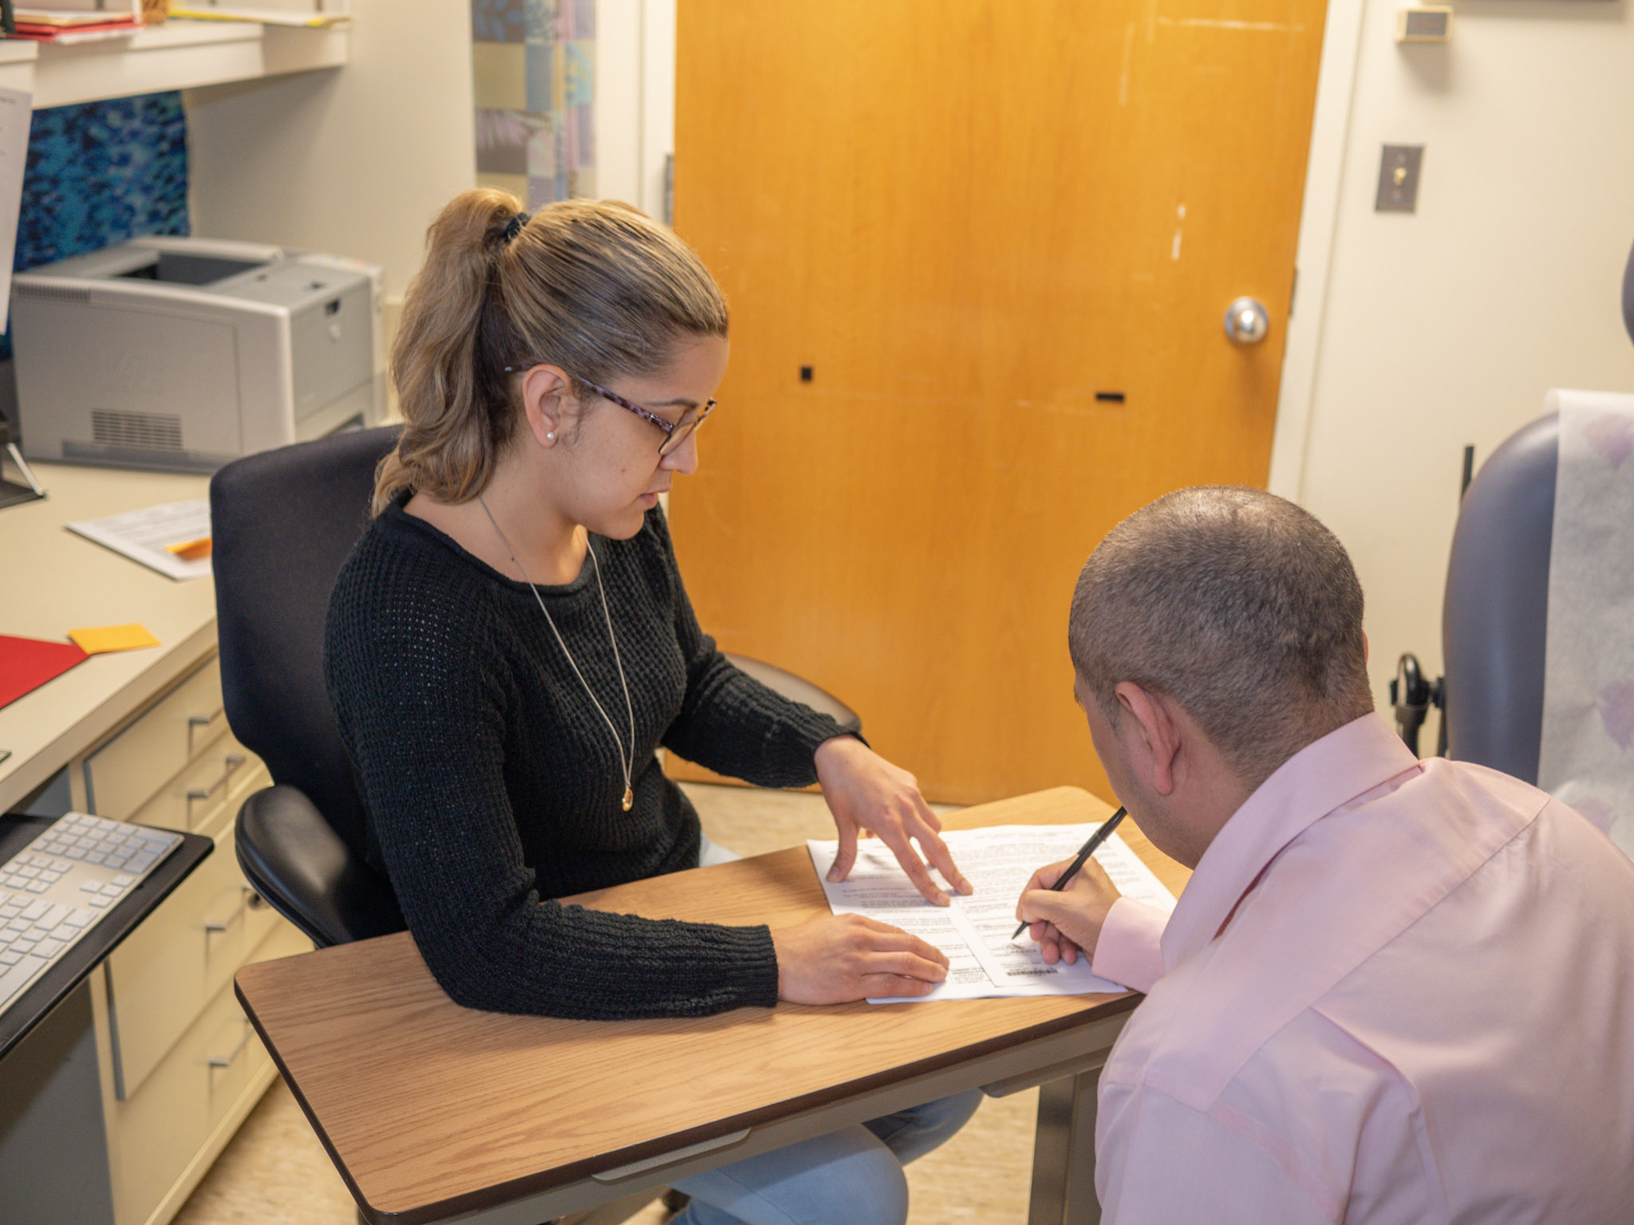
Informed Consent as a Process
Informed consent is a process that begins with the recruitment and screening of a subject and continues throughout the subject's involvement in the research.
Process includes:
  Providing information about the study to subjects in a way that is understandable to them.
  Answering questions
    Make sure the participant(s) understand the research and their role in it.
  Giving subjects sufficient time to consider their decisions.
Obtaining the voluntary agreement of subjects to take part in the study.
  The agreement is only to enter the study.
  Subjects can decide to withdraw at any time, decline to answer specific questions, or complete specific tasks during the research.
This image by NIAID is licensed under CC BY 2.0.
Notes:
Speaker: Rodney

Slide 17
Documenting Informed Consent
Ways to obtain Informed Consent:
  Signed signature (preferred)
    Physical Paper
    Electronic via email or Adobe
    Must have a unique signature signed by the participant or their Legal Authorized Representative
  Electronic (requires a Waiver on file)
    Often used for online survey studies. The participant can select a radio button that says “I have read and understand the consent information. I agree to take part in this research”
  Verbal/Oral (requires a Waiver on file)
    Rarely used
Waiver/Alteration of Informed Consent
  The federal regulations allow researchers to modify or waive the consent process.
This image by NIAID is licensed under CC BY 2.0.
Notes:
Speaker: Rodney
Verbal Consent: Used in circumstances where cultural differences may not allow for participants to sign (study with natives who believed signing documents gave undue power over someone else).

Slide 18

What does an Informed Consent need to include?
Federal regulations at 45 CFR 46 (Protection of Human Subjects 2018) list specific, MANDATORY elements of information that must be provided to subjects about informed consent.
Expected time commitment
Anticipated benefits
(For the subject and/or field of study.)
Foreseeable risks.
Contact information for participants to ask questions.
Description of the procedures to be followed
Photo by sepyle86 is marked with Public Domain Mark 1.0.
Purposes of the research
Alternative procedures or courses of treatment (if applicable)
“Participation is voluntary, the subject may discontinue participation at any time without penalty or loss of benefits”
Notes:
Speaker: Rodney

Slide 19
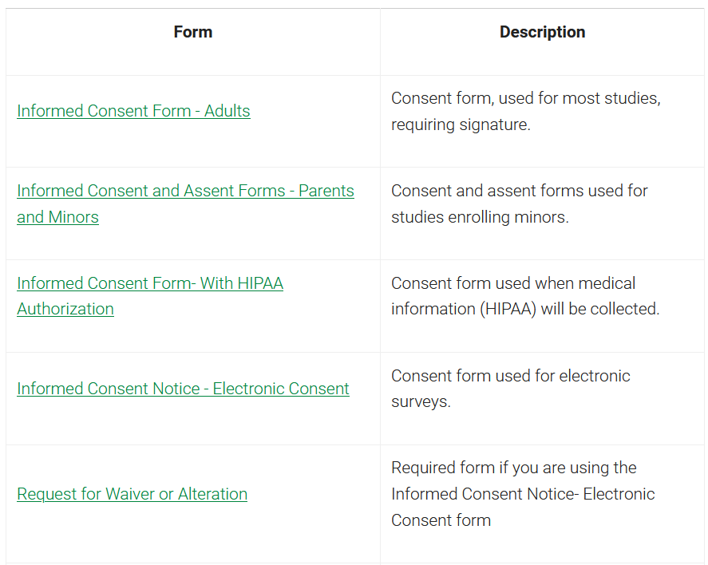
Informed Consent Templates
We have templates available on our Forms and Templates webpage!
  Search: UNT IRB forms
If you are obtaining electronic consent through an online survey, don’t forget to complete the Request for Waiver or Alteration
All consent documents (and waivers) should be uploaded to in Cayuse submission
Notes:
Speaker: Rodney

Slide 20
Upcoming RCR Workshops
Notes:
Speaker: Rodney
Verbal consent:

Slide 21
Responsible Conduct of Research(RCR) Workshops
Fall 2024
IRB- Human Subjects Research
COI- Conflict of Interest
Export Control
Animal Research
& Biosafety
September 25th
October 1st
October 16th
November - TBD
Via Zoom at 2:00 pm
Overview of UNT IRB
Information on how to prepare a human subject's application for submission
Basics of Informed Consent
Recruitment Methods
Via Zoom at 2:00 pm
Overview of the UNT COI program.
Difference between research conflicts of interest (RCOI) and institutional conflicts of interests (ICOI).
Considerations for competitive small business funding programs such as Small Business Innovation Research (SBIR) and Small Business Technology Transfer (STTR).
International Affiliations
Via Zoom at 2:00 pm
Overview on how to navigate international affiliations in research.
International affiliations disclosure process
Visiting Scholars program
Compliance requirements related to international affiliations in research.
Via Zoom at 2:00 pm
Overview of UNT’s IACUC and biosafety programs and how they relate.
General Animal Lab Safety
Guidance on biological safety and risk assessment for work involving animals.
Notes:
Speaker: Hannah

Slide 22
Questions?
THANK YOU!
Phone: 940-565-4643
Email: untirb@unt.edu
Messaging on Microsoft Teams
One-on-one meetings by appointment via Microsoft Teams or Zoom
Notes:
Speaker: All! ☺

