Slide 1
Responsible Conduct of Research
International Affiliations
March 26, 2024

Slide 2
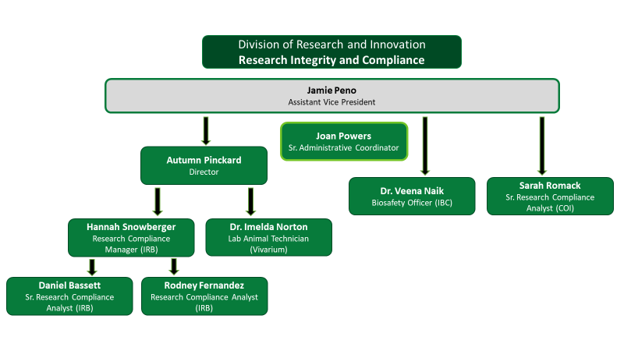
Division of
Research and Innovation
Research Integrity and Compliance
Jamie Peno
Assistant Vice President- RIC
IRB
COI
IACUC
Export Control
RCR
Christina Cantu
Sr. Administrative Associate
Hannah Snowberger
Sr. Research Compliance Analyst
Autumn Pinckard
Research Compliance Manager
Sarah Romack
Research Compliance Analyst
IRB
IRB
IACUC
COI
Operations

Slide 3
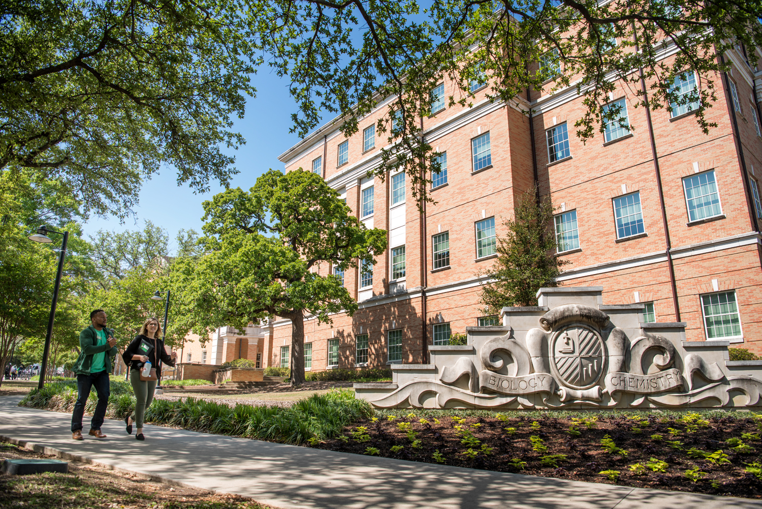
What are we going to talk about?
What is the goal of the International Affiliations Program?
Where/how should disclosures be made?
IA Disclosure Filing Process
Dean Reports
Overlaps with COI/Outside Employment
Q&A

Slide 4
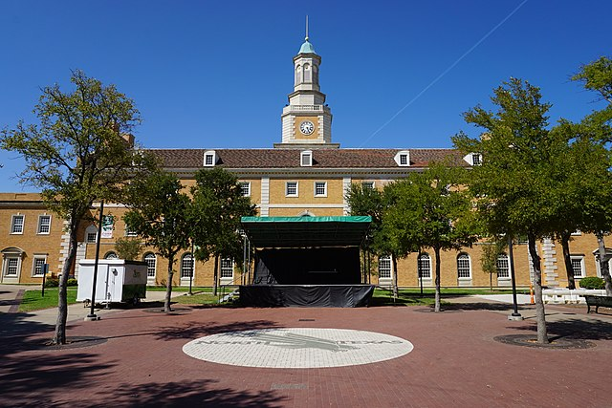
What is an International Affiliation?
Giving a talk internationally
Sharing data or materials
Collaborating on a research project
Hosting international students or scholars
Accepting an overseas appointment
This Photo by Unknown Author is licensed under CC BY-SA

Slide 5
Why increased research security concerns?
Giving a talk internationally
Sponsor approval, data theft, export control, personal safety
Sharing data or materials
Intellectual property, shipping safety, export control
Collaborating on a research project
Improper authorship attribution, conflicting integrity rules, sponsor agreement restrictions, reputational risks
Hosting international students or scholars
Intellectual property theft, access to restricted equipment/information, bad actors
Accepting an overseas appointment
Talent program, federal sponsor requirements, committing to more effort than time available

Slide 6
What is the goal of the International Affiliations program?
Encourage, support, & foster faculty collaboration
Collaboration leads to innovation
Economic growth & development
Highly sought after in corporate research
Improving scientific & diplomatic relations
Balancing promotion & protection
Address US Government sponsors’ concerns
Meet university and legal requirements
Preserve research integrity
Protect academic freedom
Protect human participants
Protect interests of students and staff
This Photo by Unknown Author is licensed under CC BY-SA

Slide 7
Why the concern with International Affiliations?
Federal
CHIPS and Science Act
NSPM-33
NIST 800-171
State
SB 1565
Sponsor-specific
NSF MFTRP Certification (PAPPG 24-1)
NSF Research Security training (PAPPG 25-1)
DOD CMMC requirements

Slide 8
Where/how should disclosures be made?
In Proposals, Progress Reports, and Final Reports:
• Identify all sites where work will be performed, domestic and abroad.
• Biosketch (NIH, DOD, NSF, DOE, etc): Identify all appointments at foreign entities, participation in foreign talent program(s) and all foreign relationships and activities.
• Current & Pending Support: Identify all financial resources, domestic and foreign, supporting your research.
• Foreign components: Identify all known foreign components to a research project in the initial proposal and update as necessary via subsequent progress reporting.
Adapted from: https://customsitesmedia.usc.edu/wp-content/uploads/sites/522/2020/11/20184132/Foreign-Influence-presentation-11.18.20FINAL.pdf

Slide 9
Where/how should disclosures be made?
During the Award:
If a foreign component arises during the life of the award and was not disclosed in the initial proposal, obtain sponsor’s approval through a progress report or stand-alone request.
At the University:
• All research activity at another institution requires disclosure to the appropriate Dean and the Vice President of Research & Innovation via the International Affiliations disclosure process.
• Academic titles at other institutions (foreign or domestic), including full-time, parttime, visiting, adjunct, honorary, or voluntary appointments, require approval from the Dean via Outside Employment form.
• All researchers regardless of sponsor or title must submit an International Affiliations disclosure
Adapted from: https://customsitesmedia.usc.edu/wp-content/uploads/sites/522/2020/11/20184132/Foreign-Influence-presentation-11.18.20FINAL.pdf

Slide 10
How do I submit my IA Disclosure?
A link to a Qualtrics survey will be sent every April.
You will be asked about:
Support: Funding, In-Kind (equipment, supplies, lab resources)
Affiliations: Paid/unpaid appointments, Honors, Teaching, Advisory
Agreements & Contracts: Consulting, Honorariums
Travel: funded by international entity & NOT processed through UNT
Visitors: if NOT processed by Visiting Scholars Program
Exports: Shipments to international locations (Export Control/Biosafety)

Slide 11
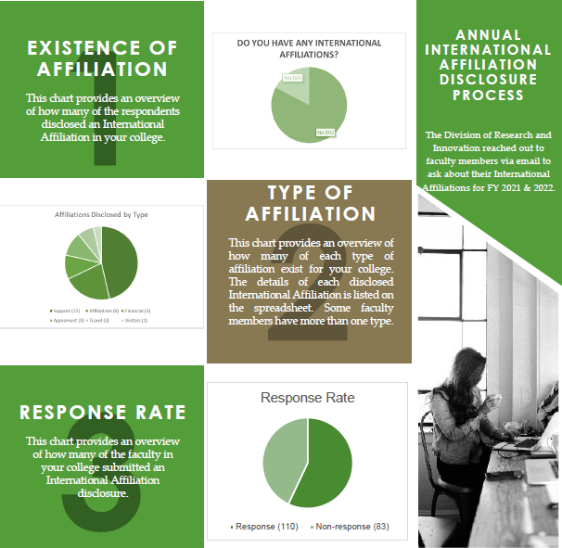
What happens with this information?
RIC can adjust support/resources
Training
Website information
Aggregated reports to Deans
Visual Compliance checks
Best practices discussion
Outside Employment form

Slide 12
PAPPG 24-1 MFTRP Certification
On February 19th, the NSF officially released the Proposal & Award Policies & Procedures Guide 24-1.
It goes into effect on May 20, 2024
In anticipation, our office added a question about Malign Foreign Talent Recruitment Program on January 1, 2024
Even if you submitted a COI Disclosure on 12/31/23, you’ll need to submit a new disclosure if submitting a proposal

Slide 13
Malign Foreign Talent Recruitment Program
A Foreign/international talent recruitment program (FGTRP) is an effort organized, managed, or funded by a foreign government, or a foreign government instrumentality or entity, to recruit science and technology professionals or students (regardless of citizenship, national origin, or full-/part-time status).
Incentivizing/compensating the FGTRP participant to relocate physically to a foreign country in order to import/acquire the proprietary technology, software, etc.;
Allowing for or encouraging the FGTRP participant to receive U.S. Federal research funds while concurrently working at and/or receiving compensation from a foreign institution for the same, or similar, work;
Directing FGTRP participants not to disclose their participation to United States entities;
Compelling FGTRP participants to enter into contracts that conflict with their responsibilities to UNT, or that are disallowed by UNT
OFAC-sanctioned countries: Russia, Iran, China and North Korea

Slide 14
Malign Foreign Talent Recruitment Program Warning Signs
Cold-contact from a researcher you don’t know
Researchers told not to tell university
Researchers are asked to provide information normally not shared in exchange for benefits
Financial assistance that circumvents detection
Legitimate cooperation = transparent & adheres to federal assistance rules

Slide 15
Questions?
THANK YOU!
Phone: 940-565-4643
Email: untcoi@unt.edu

Slide 16
Questions?
THANK YOU!
Phone: 940-565-4643
Email: untcoi@unt.edu

