Slide 1




February 3, 2026
Export Control
Office of Research Integrity & Compliance
Presented by: Meg Cochran, Research Security and Export Control Officer

Slide 2
What we will Cover:
Terms
Our team
What is export control?
What is an export?
Fundamental Research Exclusion
ITAR and EAR
Deemed exports
Consequences for violations
Export control at UNT
Insider threat
Resources

Slide 3

Research Integrity & Compliance
Pam Padilla
Vice President for Research and Innovation
VACANT
Sr. Director of Research Integrity and Compliance
Chris McMullen
Sr. Administrative Coordinator of Research Compliance
Sarah Romack
Dir. of Ethics & International Research Compliance
VACANT
BioSafety Officer
(IBC)
Dr. Imelda Norton
Research Lab Manager
(IACUC)
Daniel Bassett
Director
(IACUC, IRB)
Meg Cochran
Research Security & Export Control Officer
Julia Kissling
Research Compliance Analyst
Hannah Taylor
Research Compliance Analyst
Joan Powers
Sr. Research Compliance Analyst (IRB)
Rodney Fernandez
Sr. Research Compliance Analyst (IRB)
Tracee Kelly
Research Compliance Analyst (IRB)

Slide 4


What is an Export?
Anything that is sent from the U.S. to a foreign destination
Sharing controlled technology/source code to a foreign national in the U.S. is a “deemed” export to the country of the foreign national.
Export includes items transferred to a U.S. subsidiary and/or U.S. government installation in a foreign country (such as a military base)
Methods of Export
    Software uploaded to or downloaded from an Internet site
    Mail, hand carried on a plane, fax
    Technology discussed via email or during a phone conversation

Slide 5

What is Export Control?
Export controls are a set of regulations that govern the transfer of controlled items or information to foreign nationals, countries, and entities.
  Samples, substances, data, and information can all be considered exports.
  Exporting something can mean sharing it with a foreign national.
  Something DOES NOT HAVE TO LEAVE THE UNITED STATES to be considered a deemed export.
Export Controls are U.S. laws and regulations that regulate and restrict the release of critical U.S. technology, information, and training to foreign nationals, within the United States, and foreign countries for reasons of foreign policy and national security.

Slide 6
Terms
International Traffic in Arms Regulations (ITAR)
  Regulates the export of military grade services, software, and data.
  Directorate of Defense Trade Controls (DDTC) under Department of State (DoS)
  United States Munitions List (USML)
Export Administration Regulations (EAR)
  Regulates a broader range of items than ITAR, including commercial and Dual-use technologies
  Bureau of Industry and Security (BIS) under Department of Commerce (DoC)
  Export Control Classification Number (ECCN) –Specific category of controlled product
  EAR99- Broader category for NLR goods
Office of Foreign Assets Control (OFAC)
  Sanctions
  Department of Treasury (DoT)
  Specially Designated Nationals List (SDN)
Controlled Unclassified Information (CUI)
  Information that does not meet the criteria for classification, but that still must be protected. CUI is information that is created or possessed by the US government or by other entities on its behalf.

Slide 7
International Traffic in Arms Regulations
(ITAR)
Department of State, Directorate of Defense Trade Controls (DDTC)
Has primacy over all export regulations
Methods for exporting legally:
  Export License
  Agreement
  Technical Assistance Agreement (TAA)
  Exemption ( AKA: Waiver)
Violations can be costly:
Example: Airbus agreed to settle 75 charges of violations of the ITAR by its subsidiaries. Jan 27, 2020
- Omitted material facts regarding the payment of commissions, fees, or political contributions paid
- Unauthorized reexport of ITAR technology. Result: $10,000,000, fine

Slide 8
Export Administration Regulations (EAR)
Department of Commerce
Bureau of Industry and Security (BIS)
Methods for Exporting Legally
Export License
No License Required (NLR) – also applies to EU regulations
Exemption (a.k.a. waiver)
EAR99 is a classification designation for an item that is subject to the EAR but not specifically described by an ECCN ( export control classification number) on the CCL (commerce control list). NLR, which stands for “No License Required,” is a shipment designation.

Slide 9
Fundamental Research Exclusion
Fundamental Research Exclusion (FRE) is a federal government exemption that protects research information from export controls and allows universities to conduct research without licenses.
What it covers
The FRE applies to research information that could be publicly shared, including unclassified research. It does not apply to materials or items that are intended to be transferred or shipped internationally.
What it doesn't cover
The FRE doesn't apply to proprietary research or industrial development, design, production, and product utilization.
What it allows
The FRE allows universities to conduct research without licenses and allows foreign researchers to participate in basic research

Slide 10
Fundamental Research Exclusion Requirements
What is required to be considered fundamental research:
Must be basic or applied research in engineering or science.
Must be conducted within the United States.
Must have no publication restrictions (other than a limited review.)
Must have no restrictions on the nationality of personnel who can be involved in the research.
Must be public domain or destined to be public domain.

Slide 11


Deemed Export
What is a Deemed Export?
  Any release of technology or source code subject to the EAR/ITAR to a foreign national
  Such “release” is deemed to be an export to the home country or countries of the foreign national
What does “release” mean?
  Visual inspection by foreign nationals of U.S.-origin equipment and facilities
  Oral exchanges of information in the United States
  The application of personal knowledge or technical experience acquired in the United States – i.e. training
What Technology?
  All technology except:
    Technology under the jurisdiction of another agency
    Printed books
    Publicly available technology
    Technology that arises during or results from fundamental research

Slide 12
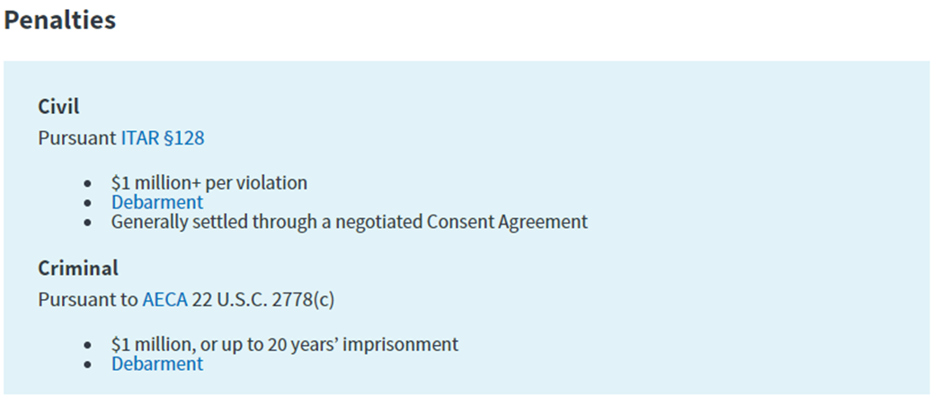
Consequences for Violations
Violations
ITAR/EAR violations may result in civil and/or criminal penalties, including fines and debarment
The Directorate of Defense Trade Controls (DDTC)/Bureau of Industry & Security (BIS) is responsible for civil enforcement of the regulations, while the Department of Justice handles criminal matters.
Consequences can include increased compliance oversight, the loss of business opportunities, as well as civil and criminal penalties.

Slide 13
Export Control at UNT
Research Security and Export Control Officer and Data Analyst in the Research Integrity and Compliance office of the Division of Research and Innovation.
International Travel Device Checklists
Export Control works with International Risk Control Coordinator to ensure foreign travel is compliant with institutional and federal and state policy
Loaner laptops
Restricted party screenings
Technology control plans
Export Control Training available- Live/ Recorded, CITI Modules
Research Security Committee

Slide 14

Insider Threat Awareness
Insider Threat is the likelihood, risk, or potential that an insider will use his or her authorized access, wittingly or unwittingly, to do harm to the national security of the United States or to the institution.
Higher education institutions and their employees are a top target for foreign intelligence services that seek information regarding:
  U.S. technologies
  Federally funded research
  Intellectual property
  Classified or controlled unclassified information (CUI), (e.g., export‐controlled, proprietary, financial)
  Other sensitive information that could lead to a military, technological, or economic advantage.

Slide 15
Malign Foreign Talent Recruitment Programs
A Malign Foreign/international talent recruitment program (MFTRP) is an effort organized, managed, or funded by a foreign government, or a foreign government instrumentality or entity, to recruit science and technology professionals or students (regardless of citizenship, national origin, or full-/part-time status).
MFGTRPs raise U.S. sponsor concerns when they appear to operate with the intent of acquiring proprietary technology or software, unpublished data and methods, or other intellectual assets to further the military and/or economic goals of a foreign government through actions including, but not limited to:
Incentivizing/compensating the MFTRP participant to relocate physically to a foreign country in order to import/acquire the proprietary technology, software, etc.;
Allowing for or encouraging the MFTRP participant to receive U.S. Federal research funds while concurrently working at and/or receiving compensation from a foreign institution for the same, or similar, work;
Directing MFTRP participants not to disclose their participation to United States entities;
Compelling MFTRP participants to enter into contracts that conflict with their responsibilities to UNT, or that are disallowed by UNT.

Slide 16

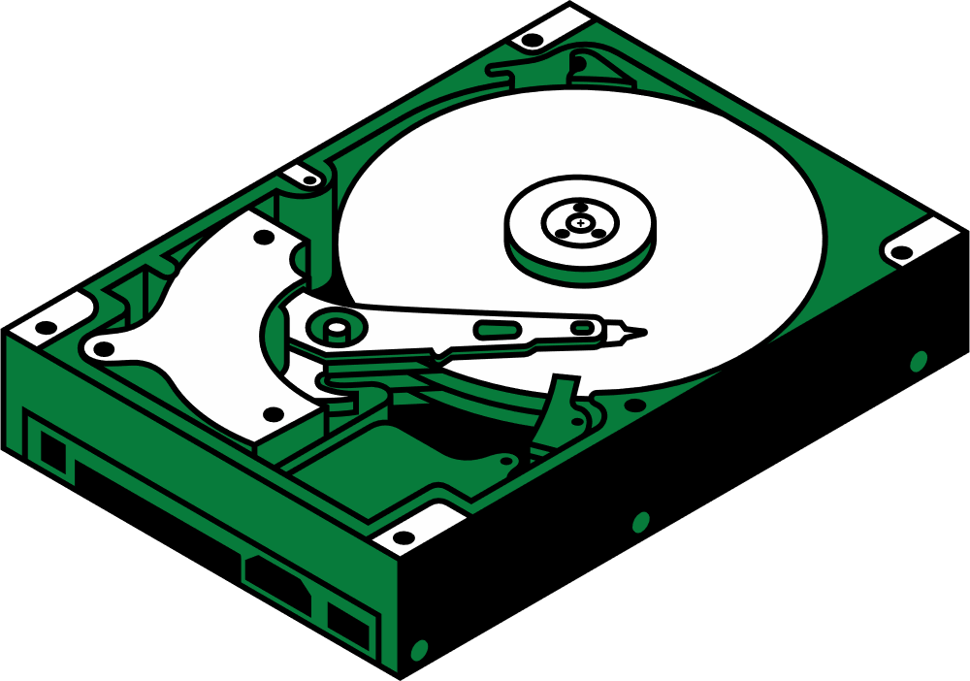
Information Collection
  Keeping materials in an unauthorized location
  Attempting to access information without authorization
  Obtaining access to information inconsistent with duty requirements
Information Transmittal
  Using an unauthorized medium to transmit sensitive materials
  Discussing sensitive materials with people not authorized to access that information

Slide 17
Additional Suspicious Behaviors
Repeated or unrequired work outside of normal hours
Accessing protected areas/information after hours, at unusual times, repeated issues with locking secure areas, etc.
Sudden changes in financial situation
new debts/financial anxiety
Displays of wealth not congruent with type of employment
Attempts to conceal foreign travel
Unregistered trips
Unaccounted for absences

Slide 18


  Stay alert to behavior and security measures for sensitive materials.
  Share observations with supervisor or Export Control Officer.
  If you see something, say something.
  Reminders are OK, but do not confront someone if you have suspicions.
What Can I Do?

Slide 19



Questions?
THANK YOU!
  Phone: 940-565-4658
  Email: oric@unt.edu
  Margaret.cochran@unt.edu

