Slide 1













Responsible Conduct of Research
IRB Overview
Responsible Recruitment and Elements of Informed Consent
Date: February 11, 2026

Slide 2


Research Integrity & Compliance
Pam Padilla
Vice President for Research and Innovation
VACANT
Sr. Director of Research Integrity and Compliance
Chris McMullen
Sr. Administrative Coordinator of Research Compliance
Sarah Romack
Dir. of Ethics & International Research Compliance
VACANT
BioSafety Officer
(IBC)
Dr. Imelda Norton
Research Lab Manager
(IACUC)
Daniel Bassett
Director Research Compliance Programs
Meg Cochran
Research Security & Export Control Officer
Julia Kissling
Research Compliance Analyst
Hannah Taylor
Research Compliance Analyst
Joan Powers
Sr. Research Compliance
Analyst (IRB)
Rodney Fernandez
Sr. Research Compliance
Analyst (IRB)
Tracee Kelly
Sr. Research Compliance Analyst (IRB)

Slide 3

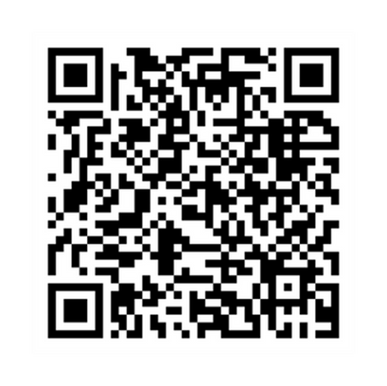
The Regulations
45 CFR 46- Common Rule
  Federal regulations that govern Human Subjects Research
  Provides guidance in the protection of the rights, welfare, and wellbeing of human subjects involved in research conducted or supported by the U.S. Department of Health and Human Services (HHS)
Department of Health and Human Services
  Office for Human Research Protections (OHRP)
The Declaration of Helsinki (1964)
  World Medical Association
  Ethical principles for medical research involving human subjects
The Belmont Report (1979)
  National Commission
  Three key ethical principals that form the ethical foundation for federal regulations
        Respect for persons
        Beneficence
        Justice
Notes:
https://www.hhs.gov/ohrp/regulations-and-policy/regulations/45-cfr-46/index.html

Slide 4
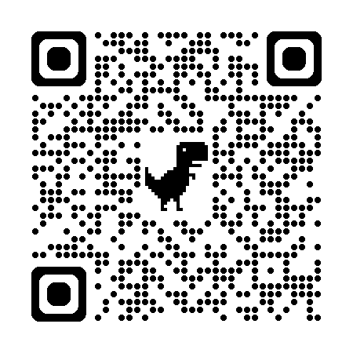
Before the Regulations
Tuskegee Study (1932-1973)
Doctors studying the effects of syphilis on participants whilst denying them the benefits of any treatments
Stuttering Study (1939)
Physical/verbal abuse of children in an orphan's home to try to prove stuttering can be induced.
Nuremburg Trials (1946)
Criminal proceedings were brought against 23 German doctors for participating in war crimes and crimes against humanity.
The Immortal Life of Henrietta Lacks (2010)
Her cancer cells were the originators of the HeLa cell line, an incredibly robust line that has contributed to countless scientific advances over the years.
Facebook Emotional Contagion Study (2014)
Facebook conducted an experiment in which the news feeds of over 600,000 Facebook users were manipulated without their knowledge or consent.
PRIM&R - Research Ethics Timeline (primr.org)
Notes:
USPHS- U.S. Public Health Service-- Alabama
Poor Sharecroppers; Promised free meals, transportation, and assistance with burial costs in case of death
The study started in 1932 when the treatment of syphilis was still uncertain, but by 1947 penicillin was the standard cure for the disease. The researchers did not use the drug to cure their infected subjects, and instead kept conducting research up until 1972.
“Monster Study” - threaten to ruin the reputation of the psychologists
5 children developed speech problems. Reports show that these children became withdrawn and some stopped speaking altogether. These children were as young as five years old.
The Monster Study didn’t become nationally infamous until 2001.
PRIM&R - Research Ethics Timeline (primr.org)

Slide 5
Institutional Review Board (IRB)
“An administrative body established to protect the rights and welfare of research subjects recruited to participate in research activities conducted under the oversight of the institution with which it is affiliated.”

Slide 6

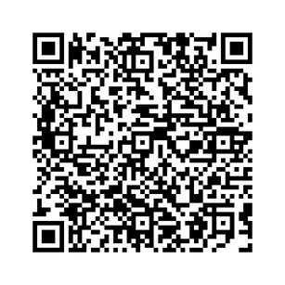

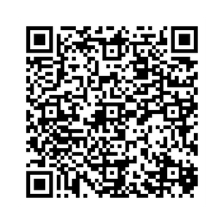

Do I Need to Submit?
Research:
The systematic investigation, including research development, testing and evaluation, designed to develop or contribute to generalizable knowledge.
Human Subject:
A living individual about whom an investigator conducting research obtains data through the intervention, or interaction with the individual or their identifiable private information.
If the answer is Yes, submit for review through Cayuse!
Cayuse Access:
To get access to Cayuse Human Ethics submission portal, submit access request form: https://research.unt.edu/cayuse-access-access-change-request
Submit an HSR Determination request to get a formal letter from the IRB!
Access Cayuse through this QR Code!
Notes:
https://research.unt.edu/support-units/research-integrity-and-compliance/human-subjects-irb/irb-protocol-submission.html
https://research.unt.edu/support-units/research-integrity-and-compliance/human-subjects-irb/human-subjects-research-determinations.html

Slide 7

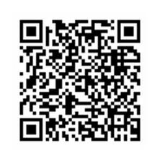
Who can be a Principal Investigator at UNT?
(PI) Principal Investigators (and Co-PIs) must be full-time UNT faculty members.
•A Full-time staff employee whose job responsibilities include conducting human subject's research may also serve as PI or Co-PI.
Cannot be:
•A Student
•A Lecturer*
•An Adjunct Instructor*
•A Postdoctoral Research Associate*
*May provide a letter or email from your Department Chair that acknowledges your research endeavors.
"Scientist" by stavos is licensed under CC BY-NC-ND 2.0
Notes:
https://www.hhs.gov/ohrp/regulations-and-policy/regulations/45-cfr-46/index.html

Slide 8

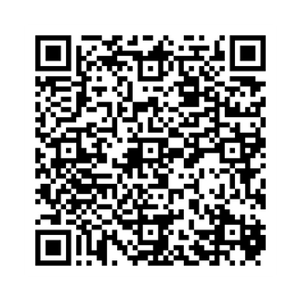

How does the Review Process work?
Analyst Pre-Review
  Research Compliance Analysts will conduct an initial review.
  If revisions are needed, we will return the study to you in the Cayuse IRB System for edits.
Respond
  Please complete the revisions in their entirety ASAP and resubmit the revised documents within the Cayuse IRB System.
Review
  Based on the risk of your study, you will be assigned a review category by the Research Compliance Analyst or Board Member:
    Exempt:: Minimal Risk:: Reviewed and approved within the Compliance Office.
    Expedited: Sent to a secondary reviewer (IRB Board Member) for final review and approval.
    Full Board: Reviewed by the IRB Members at a monthly meeting: Requires annual renewal.
Approval Documents
  Once you have satisfied all requirements and approval is issued, we will:
    Email study contacts a copy of the Approval Letter
    Attach your stamped informed consent document to your Cayuse IRB Study
Notes:
https://research.unt.edu/support-units/research-integrity-and-compliance/human-subjects-irb/irb-protocol-submission.html

Slide 9

What to Expect During the Review Process
Plan to allow sufficient time to complete your submission and navigate the review process. It is normal for submissions to require more than one review round as research projects tend to evolve. Please read all prompts and instructions in the Cayuse submission help document and throughout the application to avoid any time-consuming pitfalls.
  The current review timeline is posted in a message in the Cayuse system
    Timeline will be dependent on the volume and complexity of submissions received by the IRB office throughout the year.
    Please reach out to the office at untirb@unt.edu if you have questions regarding the posted review timeline.
Protocols that are incomplete or lack appropriate details will be returned.
Please review all study documents to assess the readiness for review.
This Photo by Unknown Author is licensed under CC BY-ND

Slide 10




MY STUDY IS APPROVED! WHAT ELSE DO I NEED TO WORRY ABOUT?
Modifications:
  Any changes to your final approved study must be approved by the IRB
  Submit a modification form before you implement any changes (i.e., adding key personnel, increasing recruitment, changes in study procedures, etc.)
Continuing Reviews:
  Full Board studies MUST be renewed each year before it is set to expire.
  Exempt and Expedited studies do not expire
Reportable Events:
  Any adverse effects, unanticipated problems, and protocol deviations or errors must be reported to our office.
Notes:
https://research.unt.edu/support-units/research-integrity-and-compliance/human-subjects-irb/irb-protocol-submission.html

Slide 11
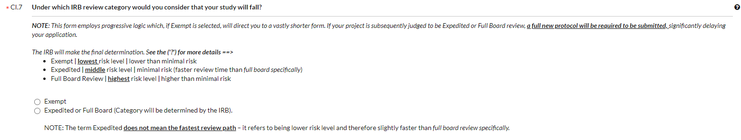


Review Categories
Exempt review study:
To qualify for an Exempt level review, the research must not be greater than “minimal risk” and:
  Does NOT involve any vulnerable populations.
  Does NOT involve any public disclosure of any identifiable data which places participants at risk.
  Does NOT involve any audio-recording or video-recording of the participants.
      (Does not apply to recordings made for the purpose of transcription)
  Does NOT involve any in-depth sensitive subject matters.
  Does NOT involve obtaining individually identifiable information protected under HIPAA.
  Typically involves the following data collection procedures.
      Surveys.
      Educational tests.
      Interviews.
      Observation of public behavior.
Examples include:
  An online Qualtrics survey about a marketing technique used in retail.
  Interviewing managers about management styles or best practices.
Notes:
https://www.hhs.gov/ohrp/regulations-and-policy/regulations/45-cfr-46/index.html

Slide 12


EXPEDITED DOES NOT MEAN FASTER

Slide 13
Review Categories: Continued
Expedited Review Category:
    To qualify for review at an Expedited level, the study must be no more than minimal risk.
    Examples include:
    Collection of data from voice, video, digital or image recording made for research purposes .
    Studies of existing pathological specimens with patient identifiers.
    Collection of a relatively small amount of blood/biological samples.
    Collection of data using minimal risk physical sensors.
Full-Board review study:
    Involves more than minimal risk studies, as determined by the IRB Chair.
    Includes any human subjects research study that does not fit into one of the federal categories for Exempt or Expedited
    Reviewed Monthly at Full-Board meetings.
    Example:
    A study on the effects of alcohol
    Research involving prisoners

Slide 14
Frequently Asked Questions
Who can be a PI?
Confidential? Or Anonymous?
Documentation
Notes:
Speaker: Hannah

Slide 15

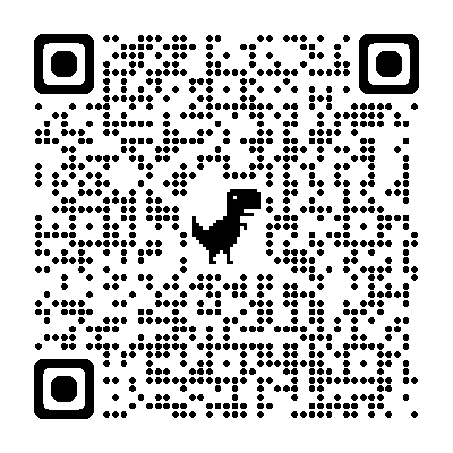
Institutional Review Board (IRB)
“How can I prepare my study for IRB submission?”
Gather your attachments.
Attachments include, but are not limited to:
Please use our
UNT IRB
templates and guides!
  Informed consent forms/notices
    Waiver or Alteration of Informed consent if using an informed consent notice
  Surveys/Questionnaires
  Training completion certificates
  Scope of work/Funding paperwork
  Recruitment materials
  Approval letters Example: ISD approval
  Data collection instruments
This Photo by Unknown Author is licensed under CC BY-ND

Slide 16
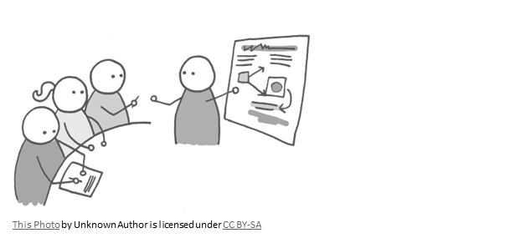
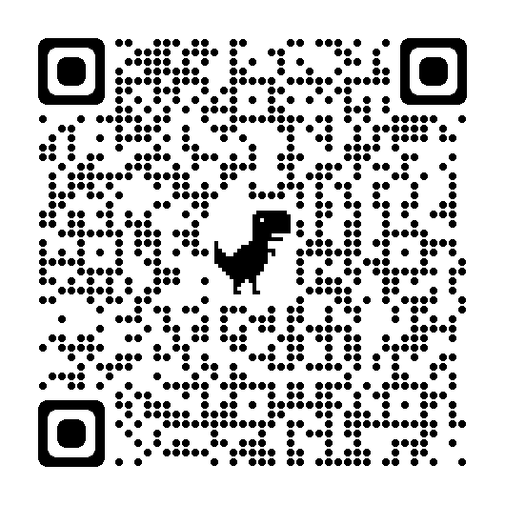
Institutional Review Board (IRB)
“What type of training do I need to complete?”
Researchers and all research team members must complete required training before they will be eligible to receive IRB approval.
Complete the Collaborative Institutional Research Initiative (CITI Program) course:
  “Social & Behavioral Research - Basic/Refresher”
  “Biomedical Research - Basic/Refresher”
Training must be renewed every 3 years
Additional Trainings:
  Responsible Conduct of Research (RCR)
  Good Clinical Practice
  Custom upon request
    Email UNTIRB@unt.edu

Slide 17
Institutional Review Board (IRB)
Confidential Vs Anonymous
In a research setting:
Confidentiality:
  The protection of information including Personal Identifiable Information (PII) disclosed to researchers during the research process
  ANY study in which there is disclosure of PII or identifiers which, when combined, can lead back to a participant is considered confidential
  This includes Names, ID numbers, birthdates, IP addresses and many more
Anonymity:
  When reidentification of a participant is considered impossible.
  The only way to render data entirely anonymous is to remove all identifying information from the data and completely disconnect any links between the subjects and data about the subjects.

Slide 18
Institutional Review Board (IRB)
Protection of Confidential Information
Even when direct identifiers are not collected, combinations of demographic questions when paired with other data could potentially be put together to identify a participant.
Data storage should be password protected and stored only on UNT-issued devices
  For electronic data, approved UNT servers (OneDrive, SharePoint, Teams) are permitted.
  Google is NOT approved, neither are personal devices
  Additional electronic storage services/applications may need to be reviewed by IT security.
Physical paper data should be stored in a locked cabinet on the UNT campus in the PI's office.

Slide 19
Institutional Review Board (IRB)
Use of Audio/Video Recordings.
Details must be included on the informed consent document
Voice/video images are considered Personally Identifiable Information (PII)
Researchers intended use must be disclosed
  Just for transcription?
  To be use in publications/presentations?
If it is to be used in publications/presentations, researchers must disclose how identities will be protected
Risk is heightened if used with children

Slide 20




RECRUITMENT BEST PRACTICES
Common Recruitment Methods
Things to be Mindful of
Recruitment Templates/Examples

Slide 21







Methods of Recruitment
Email
  Listservs
  Personal Contacts
  Provided by an outside source
Flyers
  Public vs. private
  Social Media (Personal vs. Managed)
  Facebook
  X
  Reddit
  Instagram
Crowdsourcing
  MTurk
  SONA
  Survey Monkey
  Snowball Sampling
  Direct Recruitment (Face to face, Announcements, Presentations)
Things to keep in mind
Participant demographics:
      Are your recruitment methods going to reach a representative sample?
      Translated Documents for Non-English-Speaking Participants
      Documents must be made available in the participant’s primary spoken language
      Avoiding coercion and undue influence in recruiting:
      Where there is an imbalance of power, there is the potential for undue influence or coercion
      Avoid only recruiting from personal contacts to help reduce any conflicts of interest
      Student emails:
      Not available at UNT – only from listservs currently available to the researcher
      Vulnerable Populations
      Federally defined but not limited to as children, prisoners, people with intellectual disabilities

Slide 22

Obtaining Permission
Areas where permission is required:
  Admins of Social Media groups
    Ex: Facebook groups, subReddits, Discord servers, chats, private servers, etc.
  Email Listservs not already available to the research team
  Private businesses/organizations
  Other universities or schools including K-12
  Permission is generally NOT required for recruitment through:
  Public spaces – e.g. notice boards
  A researcher’s personal social media accounts
  Contacting people whose information is publicly available
This Photo by Unknown Author is licensed under CC BY-NC

Slide 23

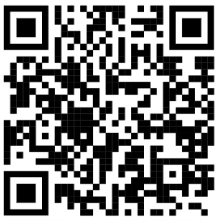
ResearchMatch
ResearchMatch is only available to be used for Health-related research studies.
ResearchMatch is a national registry of patients interested in volunteering for medical research. Anyone can register with ResearchMatch – even healthy volunteers.
  This can be a great tool to use if you are looking to recruit participants for a health-related project.
  If you are interested in learning about health-related research, YOU can sign up as a volunteer!
Notes:
https://www.researchmatch.org/

Slide 24


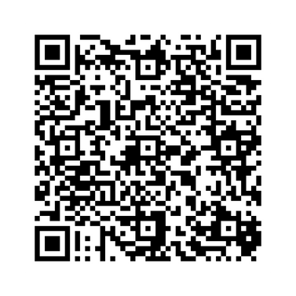
Recruitment
IRB Forms and Templates:
  Cayuse submission help document
  Recruitment Flyer & Email
    Basic template with all requirements
  Consent Templates
  Consent Alteration
    Required for all consent documents not using Pen to Paper
Recruitment Material must include:
  "University of North Texas“
  Name of Department
  The word "research“
  Official title of study
  Location of research (if online, use, "online")
  Inclusion criteria
  Purpose of study
  Study procedures and time requirement
  Type and amount of compensation (if any)
  PI name and contact information
Notes:
https://research.unt.edu/support-units/research-integrity-and-compliance/human-subjects-irb/irb-forms-and-templates.html

Slide 25

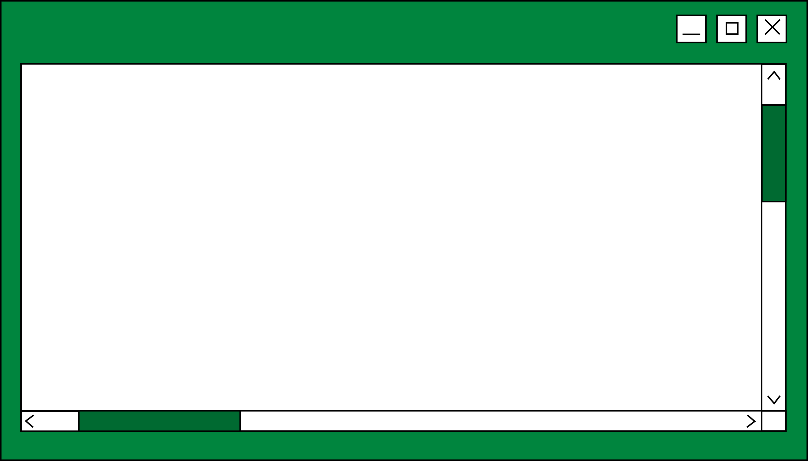

INFORMED CONSENT
  Required Elements of Informed Consent
  Documenting consent
  Resources available to UNT Investigators

Slide 26

Informed Consent as a Process
Informed consent is a process that begins with the recruitment and screening of a subject and continues throughout the subject's involvement in the research.
Process includes:
  Providing information about the study to subjects in a way that is understandable to them.
  Answering questions
      Make sure the participant(s) understand the research and their role in it.
  Giving subjects sufficient time to consider their decisions.
Obtaining the voluntary agreement of subjects to take part in the study.
  The agreement is only to enter the study.
  Subjects can decide to withdraw at any time, decline to answer specific questions, or complete specific tasks during the research.

Slide 27
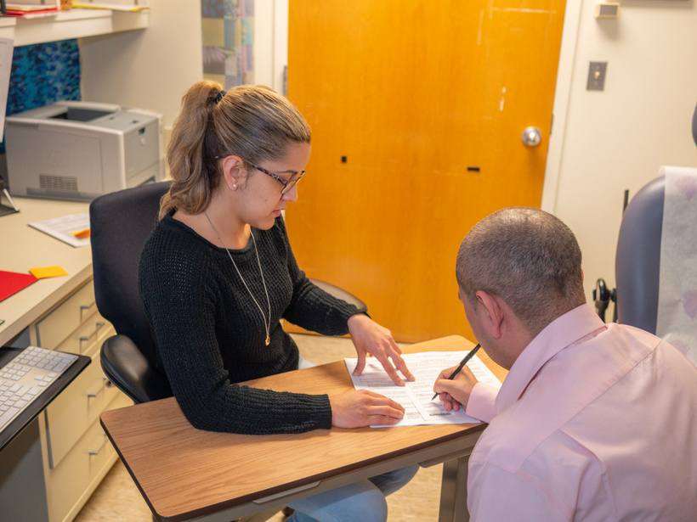
Documenting Informed Consent
Ways to obtain Informed Consent:
  Signed signature (preferred)
    Physical Paper
      Electronic via email or Adobe
      Must have a unique signature signed by the participant or their Legal Authorized Representative
  Electronic (requires a Waiver on file)
    Often used for online survey studies. The participant can select a radio button that says “I have read and understand the consent information. I agree to take part in this research”
  Verbal/Oral (requires a Waiver on file)
    Must still be recorded in some fashion, e.g. researcher notes
Waiver/Alteration of Informed Consent
    The federal regulations allow researchers to modify or waive the consent process.
This image by NIAID is licensed under CC BY 2.0.
Notes:
https://research.unt.edu/support-units/research-integrity-and-compliance/human-subjects-irb/irb-forms-and-templates.html

Slide 28







What does the Informed Consent Need to Include?
Federal regulations at 45 CFR 46 (Protection of Human Subjects 2018) list specific, MANDATORY elements of information that must be provided to subjects about informed consent.
Purposes of the research
Description of the procedures to be followed
Anticipated benefits
  For the subject and/or field of study.
Alternative procedures or courses of treatment (if applicable)
Participation is voluntary
  The subject may discontinue participation at any time without penalty or loss of benefits
Contact information for participants to ask questions.
Foreseeable risks

Slide 29


UPCOMING RCR WORKSHOPS

Slide 30
Responsible Conduct of Research(RCR) Workshops
Spring 2026
COI-Conflict of Interest
IRB- Human Subjects Research
March 3rd
Via Zoom at 2:00 pm
  Overview of the UNT COI program.
  Difference between research conflicts of interest (RCOI) and institutional conflicts of interests (ICOI).
  Considerations for competitive small business funding programs such as Small Business Innovation Research (SBIR) and Small Business Technology Transfer (STTR).
  International Affiliations
March 18ᵗʰ
Via Zoom at 2:00 pm
  Overview of UNT IRB
  Information on how to prepare a human subject's application for submission
  Basics of Informed Consent
  Recruitment Methods

Slide 31


Need Help?
  One-on-one meetings
  By appointment via Zoom or Microsoft Teams
  Call us: 940-565-4643
  Email us: untirb@unt.edu

